Slide 1

Bioinformatics Bootcamp
Fall 2020: “Programming Fundamentals and RNA-Seq analysis”
Week 3: The Tidyverse

Slide 2
How do we analyze data?

Slide 3
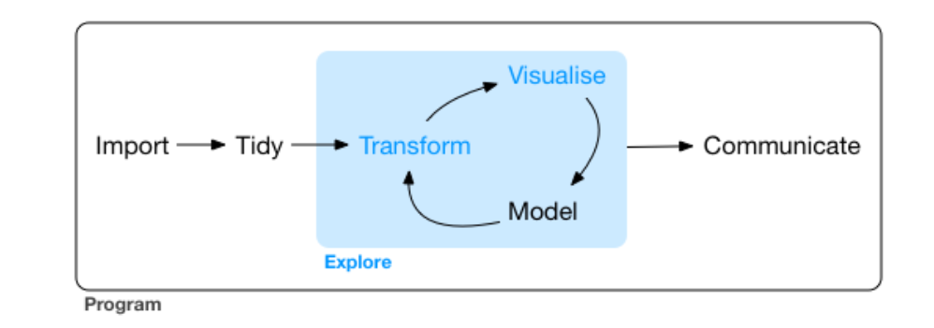
Data Analysis Workflow
https://r4ds.had.co.nz/explore-intro.html

Slide 4

https://www.tidyverse.org/images/hex-tidyverse.png

Slide 5
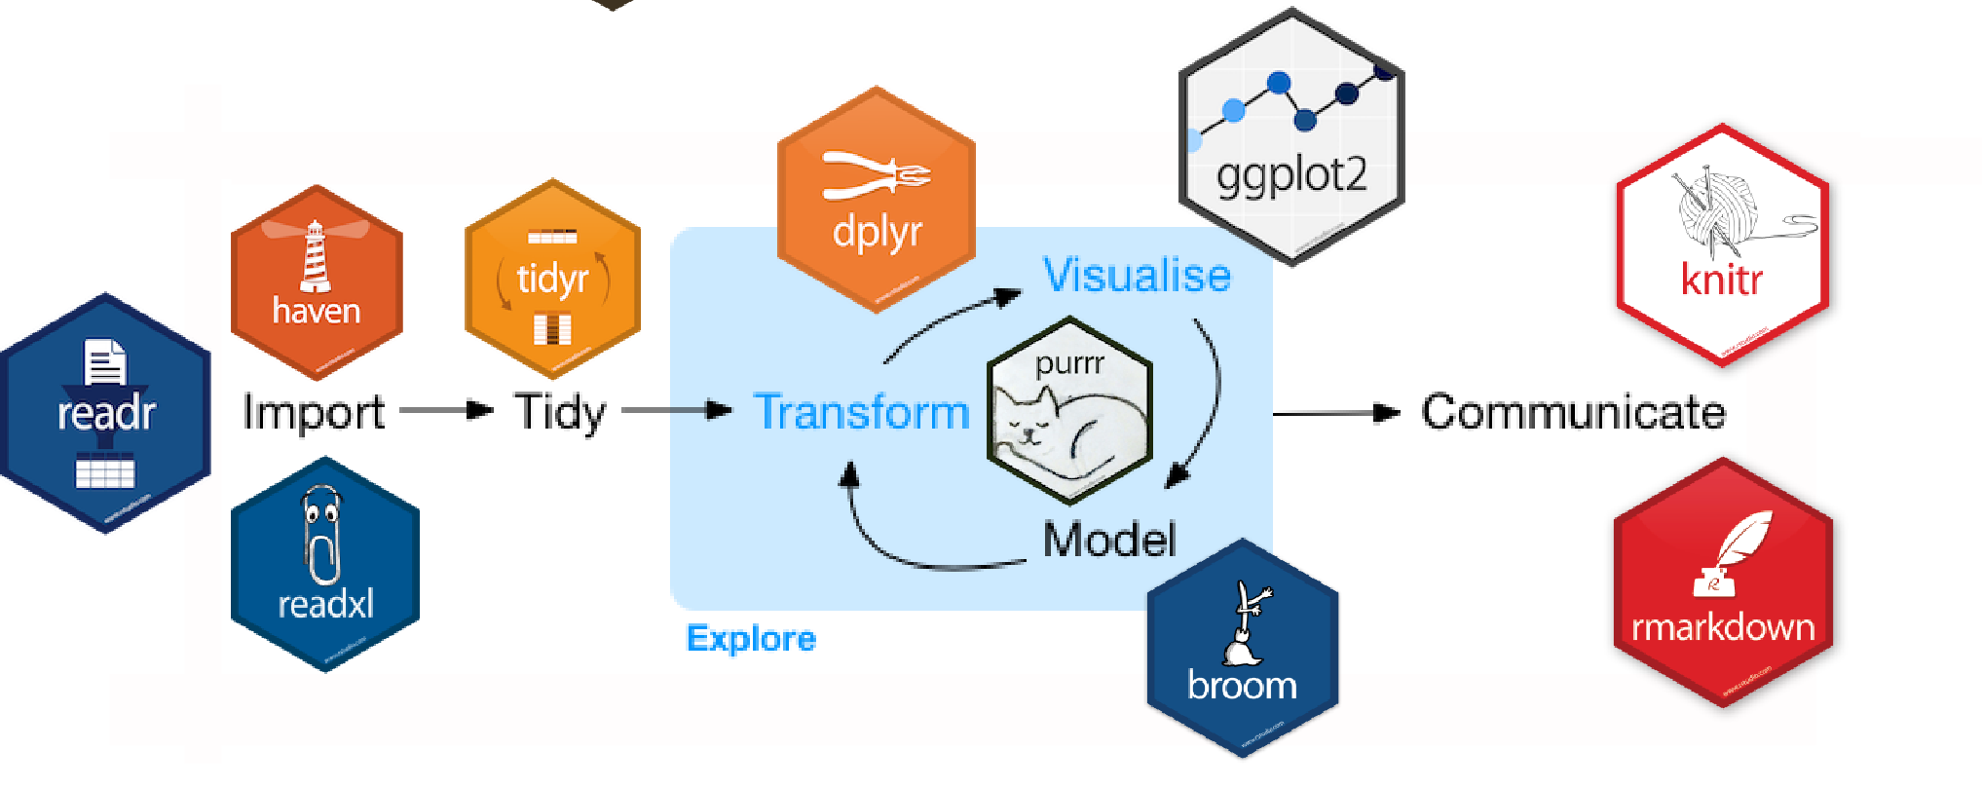
The Tidyverse
https://beanumber.github.io/tidy-databases/tidy_databases_slides.html#section

Slide 6
Outline
Wrangling the titanic dataset
Hands-on activity with mtcars dataset
Plotting the titanic dataset with ggplot2
Hands-on activity with iris dataset
Incorporating statistics into graphs with ggpubr

Slide 7
Getting started with Tidyverse

Slide 8
The pipe operator
data %>% function(arguments)
data %>%
f1() %>%
f2() %>%
f3()
data_tidy <- data %>%
f1() %>%
f2() %>%
f3()
function(data, arguments)
f3(f2(f1(data)))
data1 <- f1(data)
data2 <- f2(data1)
data_tidy <- f3(data2)

Slide 9
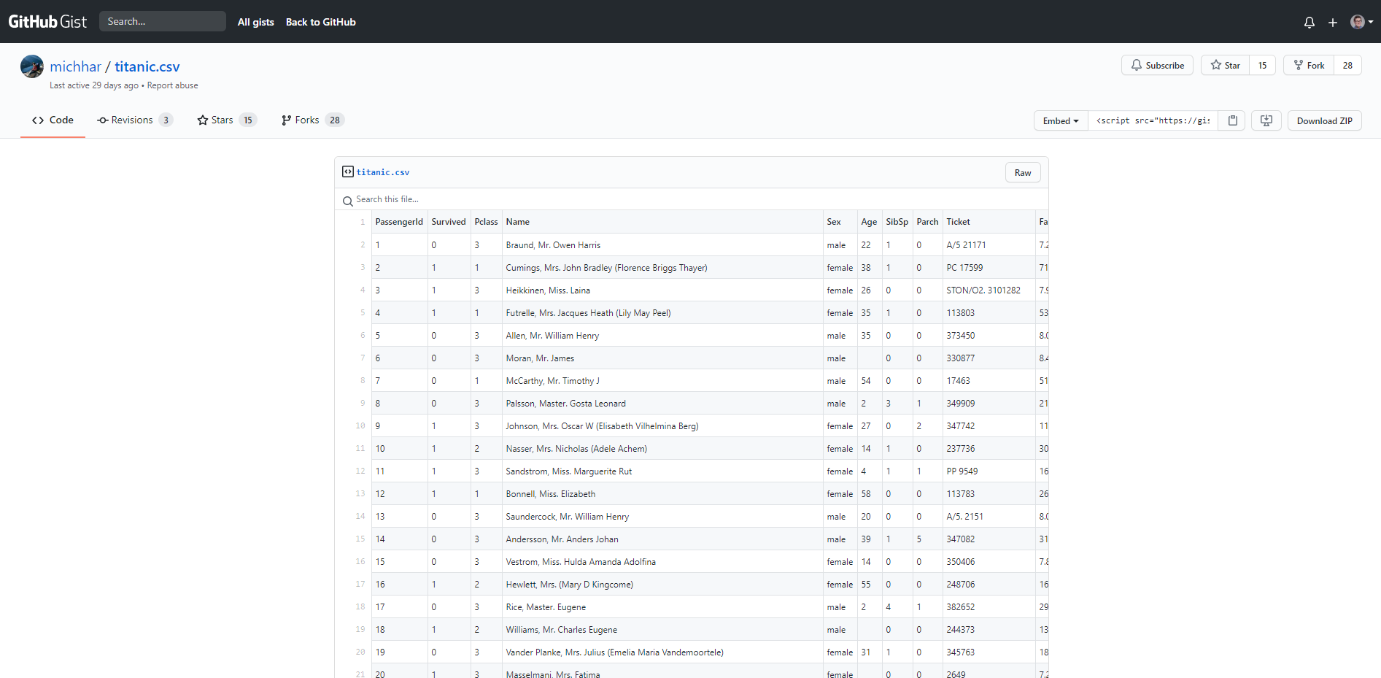

Slide 10
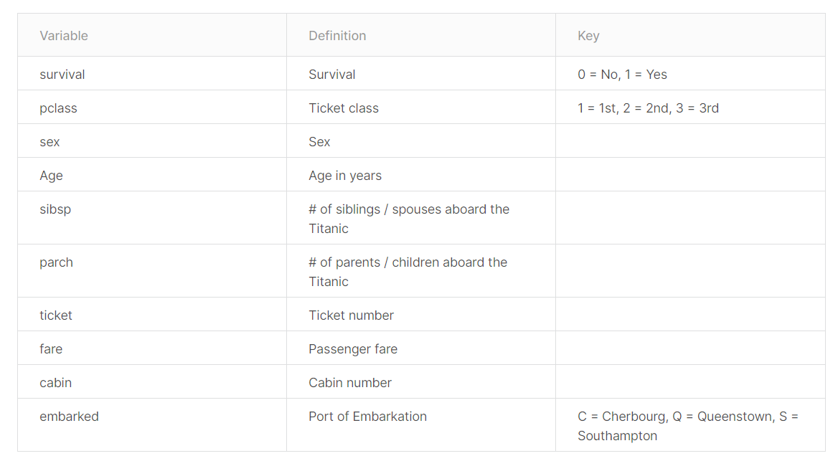

Slide 11
Getting the data (readr)
tidy_titanic <- read_csv("https://gist.githubusercontent.com/michhar/2dfd2de0d4f8727f873422c5d959fff5/raw/fa7
1405126017e6a37bea592440b4bee94bf7b9e/titanic.csv")
tidy_titanic
## # A tibble: 891 x 12 ## PassengerId Survived Pclass Name Sex Age SibSp Parch Ticket Fare Cabin ## <dbl> <dbl> <dbl> <chr> <chr> <dbl> <dbl> <dbl> <chr> <dbl> <chr> ## 1 1 0 3 Brau~ male 22 1 0 A/5 2~ 7.25 <NA> ## 2 2 1 1 Cumi~ fema~ 38 1 0 PC 17~ 71.3 C85 ## 3 3 1 3 Heik~ fema~ 26 0 0 STON/~ 7.92 <NA> ## 4 4 1 1 Futr~ fema~ 35 1 0 113803 53.1 C123 ## 5 5 0 3 Alle~ male 35 0 0 373450 8.05 <NA> ## 6 6 0 3 Mora~ male NA 0 0 330877 8.46 <NA> ## 7 7 0 1 McCa~ male 54 0 0 17463 51.9 E46 ## 8 8 0 3 Pals~ male 2 3 1 349909 21.1 <NA> ## 9 9 1 3 John~ fema~ 27 0 2 347742 11.1 <NA> ## 10 10 1 2 Nass~ fema~ 14 1 0 237736 30.1 <NA> ## # ... with 881 more rows, and 1 more variable: Embarked <chr>

Slide 12
The filter verb
tidy_titanic %>% filter(Age > 12)

Slide 13
The filter verb
tidy_titanic %>% filter(Age > 12)
## # A tibble: 645 x 12 ## PassengerId Survived Pclass Name Sex Age SibSp Parch Ticket Fare Cabin ## <dbl> <dbl> <dbl> <chr> <chr> <dbl> <dbl> <dbl> <chr> <dbl> <chr> ## 1 1 0 3 Brau~ male 22 1 0 A/5 2~ 7.25 <NA> ## 2 2 1 1 Cumi~ fema~ 38 1 0 PC 17~ 71.3 C85 ## 3 3 1 3 Heik~ fema~ 26 0 0 STON/~ 7.92 <NA> ## 4 4 1 1 Futr~ fema~ 35 1 0 113803 53.1 C123 ## 5 5 0 3 Alle~ male 35 0 0 373450 8.05 <NA> ## 6 7 0 1 McCa~ male 54 0 0 17463 51.9 E46 ## 7 9 1 3 John~ fema~ 27 0 2 347742 11.1 <NA> ## 8 10 1 2 Nass~ fema~ 14 1 0 237736 30.1 <NA> ## 9 12 1 1 Bonn~ fema~ 58 0 0 113783 26.6 C103 ## 10 13 0 3 Saun~ male 20 0 0 A/5. ~ 8.05 <NA> ## # ... with 635 more rows, and 1 more variable: Embarked <chr>

Slide 14
The select verb
tidy_titanic %>% filter(Age > 12) %>% select(Survived, Sex)

Slide 15
The select verb
tidy_titanic %>% filter(Age > 12) %>% select(Survived, Sex)
## # A tibble: 645 x 2 ## Survived Sex ## <dbl> <chr> ## 1 0 male ## 2 1 female ## 3 1 female ## 4 1 female ## 5 0 male ## 6 0 male ## 7 1 female ## 8 1 female ## 9 1 female ## 10 0 male ## # ... with 635 more rows

Slide 16
The group_by verb
tidy_titanic %>% filter(Age > 12) %>% select(Survived, Sex) %>% group_by(Sex, Survived)

Slide 17
The group_by verb
tidy_titanic %>% filter(Age > 12) %>% select(Survived, Sex) %>% group_by(Sex, Survived)
## # A tibble: 645 x 2 ## # Groups: Sex, Survived [4] ## Survived Sex ## <dbl> <chr> ## 1 0 male ## 2 1 female ## 3 1 female ## 4 1 female ## 5 0 male ## 6 0 male ## 7 1 female ## 8 1 female ## 9 1 female ## 10 0 male ## # ... with 635 more rows

Slide 18
The summarise verb
tidy_titanic %>% filter(Age > 12) %>% select(Survived, Sex) %>% group_by(Sex, Survived) %>% summarise(num_sex_survive = n())

Slide 19
The summarise verb
tidy_titanic %>% filter(Age > 12) %>% select(Survived, Sex) %>% group_by(Sex, Survived) %>% summarise(num_sex_survive = n())
## `summarise()` regrouping output by 'Sex' (override with `.groups` argument)
## # A tibble: 4 x 3 ## # Groups: Sex [2] ## Sex Survived num_sex_survive ## <chr> <dbl> <int> ## 1 female 0 51 ## 2 female 1 178 ## 3 male 0 344 ## 4 male 1 72

Slide 20
The summarise verb
tidy_titanic %>% filter(Age > 12) %>% select(Survived, Sex) %>% group_by(Sex, Survived) %>% summarise(num_sex_survive = n())
## `summarise()` regrouping output by 'Sex' (override with `.groups` argument)
## # A tibble: 4 x 3 ## # Groups: Sex [2] ## Sex Survived num_sex_survive ## <chr> <dbl> <int> ## 1 female 0 51 ## 2 female 1 178 ## 3 male 0 344 ## 4 male 1 72
Percent?

Slide 21
The mutate verb
tidy_titanic %>% filter(Age > 12) %>% select(Survived, Sex) %>% group_by(Sex, Survived) %>% summarise(num_sex_survive = n()) %>% mutate(pct_sex_survive = num_sex_survive/sum(num_sex_survive) * 100)

Slide 22
The mutate verb
tidy_titanic %>% filter(Age > 12) %>% select(Survived, Sex) %>% group_by(Sex, Survived) %>% summarise(num_sex_survive = n()) %>% mutate(pct_sex_survive = num_sex_survive/sum(num_sex_survive) * 100)
## `summarise()` regrouping output by 'Sex' (override with `.groups` argument)
## # A tibble: 4 x 4 ## # Groups: Sex [2] ## Sex Survived num_sex_survive pct_sex_survive ## <chr> <dbl> <int> <dbl> ## 1 female 0 51 22.3 ## 2 female 1 178 77.7 ## 3 male 0 344 82.7 ## 4 male 1 72 17.3

Slide 23
The mutate verb
tidy_titanic %>% filter(Age > 12) %>% select(Survived, Sex) %>% group_by(Sex, Survived) %>% summarise(num_sex_survive = n()) %>% mutate(pct_sex_survive = num_sex_survive/sum(num_sex_survive) * 100) %>% filter(Survived == 1)

Slide 24
The mutate verb
tidy_titanic %>% filter(Age > 12) %>% select(Survived, Sex) %>% group_by(Sex, Survived) %>% summarise(num_sex_survive = n()) %>% mutate(pct_sex_survive = num_sex_survive/sum(num_sex_survive) * 100) %>% filter(Survived == 1)
## `summarise()` regrouping output by 'Sex' (override with `.groups` argument)
## # A tibble: 2 x 4 ## # Groups: Sex [2] ## Sex Survived num_sex_survive pct_sex_survive ## <chr> <dbl> <int> <dbl> ## 1 female 1 178 77.7 ## 2 male 1 72 17.3

Slide 25
Save in variable
pct_surv <- tidy_titanic %>% filter(Age > 12) %>% select(Survived, Sex) %>% group_by(Sex, Survived) %>% summarise(num_sex_survive = n()) %>% mutate(pct_sex_survive = num_sex_survive/sum(num_sex_survive) * 100) %>% filter(Survived == 1)
pct_surv

Slide 26
Save in variable
pct_surv <- tidy_titanic %>% filter(Age > 12) %>% select(Survived, Sex) %>% group_by(Sex, Survived) %>% summarise(num_sex_survive = n()) %>% mutate(pct_sex_survive = num_sex_survive/sum(num_sex_survive) * 100) %>% filter(Survived == 1)
pct_surv
## # A tibble: 2 x 4 ## # Groups: Sex [2] ## Sex Survived num_sex_survive pct_sex_survive ## <chr> <dbl> <int> <dbl> ## 1 female 1 178 77.7 ## 2 male 1 72 17.3

Slide 27
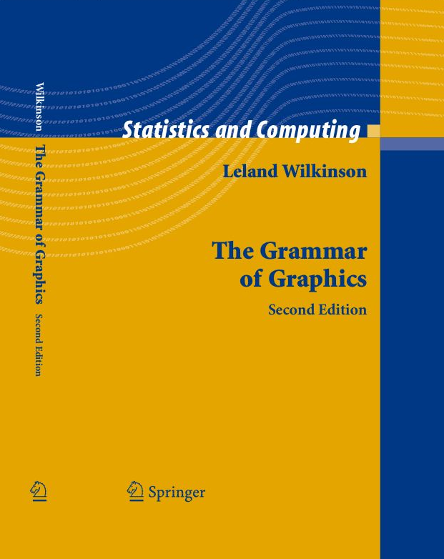
The Grammar of Graphics
A structured language for plotting
All plots follow this language
Key components:
Data
Aesthetics
Geometries
Facets
Statistics
Coordinates
Theme
https://www.cs.uic.edu/~wilkinson/TheGrammarOfGraphics/gog2.jpg

Slide 28
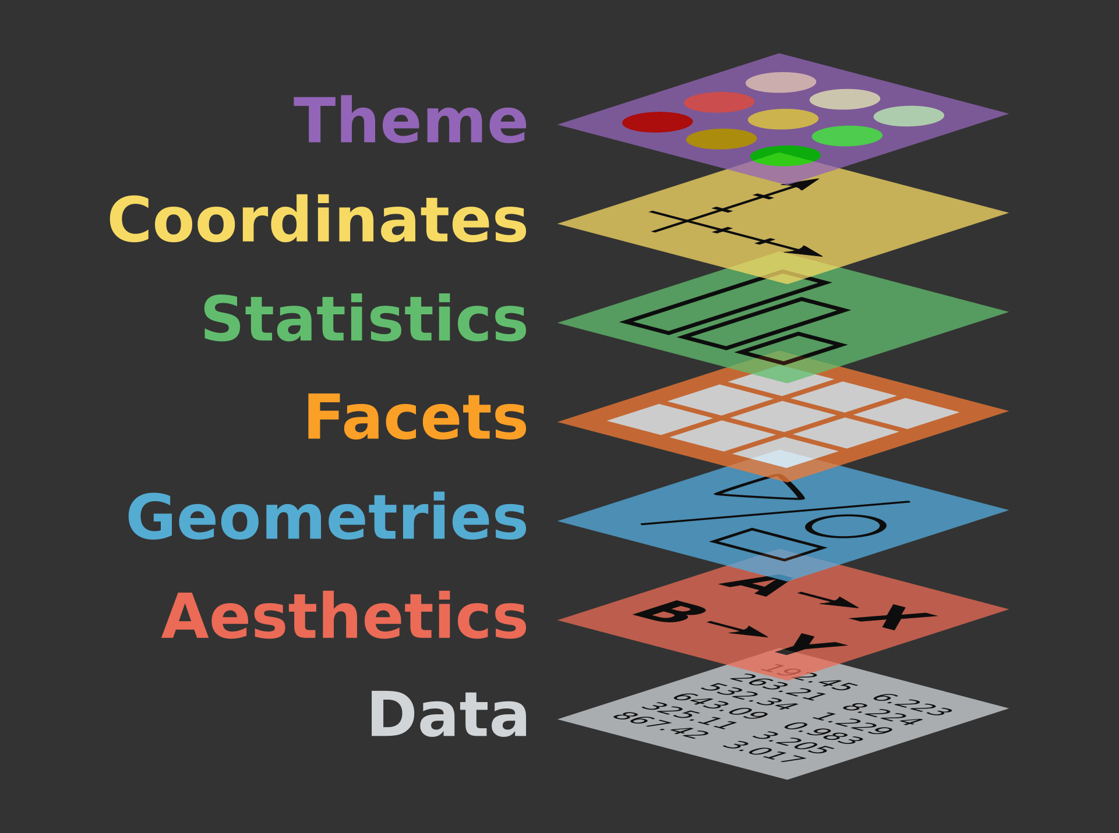
https://ggplot2.tidyverse.org/reference/index.html
Source: https://www.catallaxyservices.com/media/Grammar-Of-Graphics/#/3/3

Slide 29
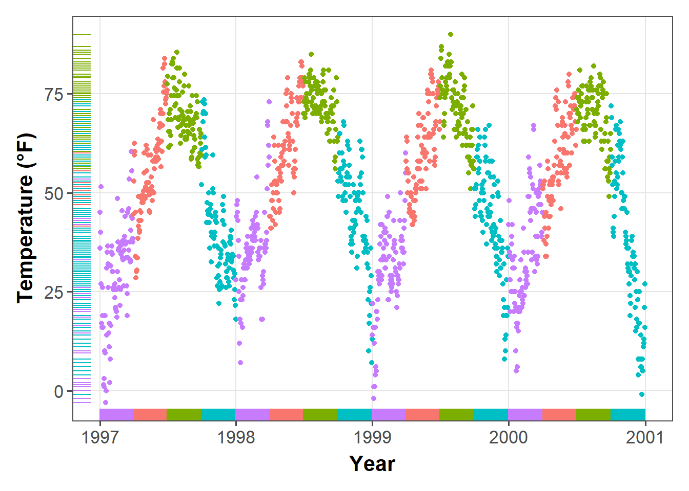
ggplot2: elegant plots using the grammar of graphics
https://d33wubrfki0l68.cloudfront.net/b6c4ce171dc7d21658771efb445b7b24b6850755/afafc/post/2019-08-05_ggplot2-tutorial_files/figure-html/rug-1.png

Slide 30
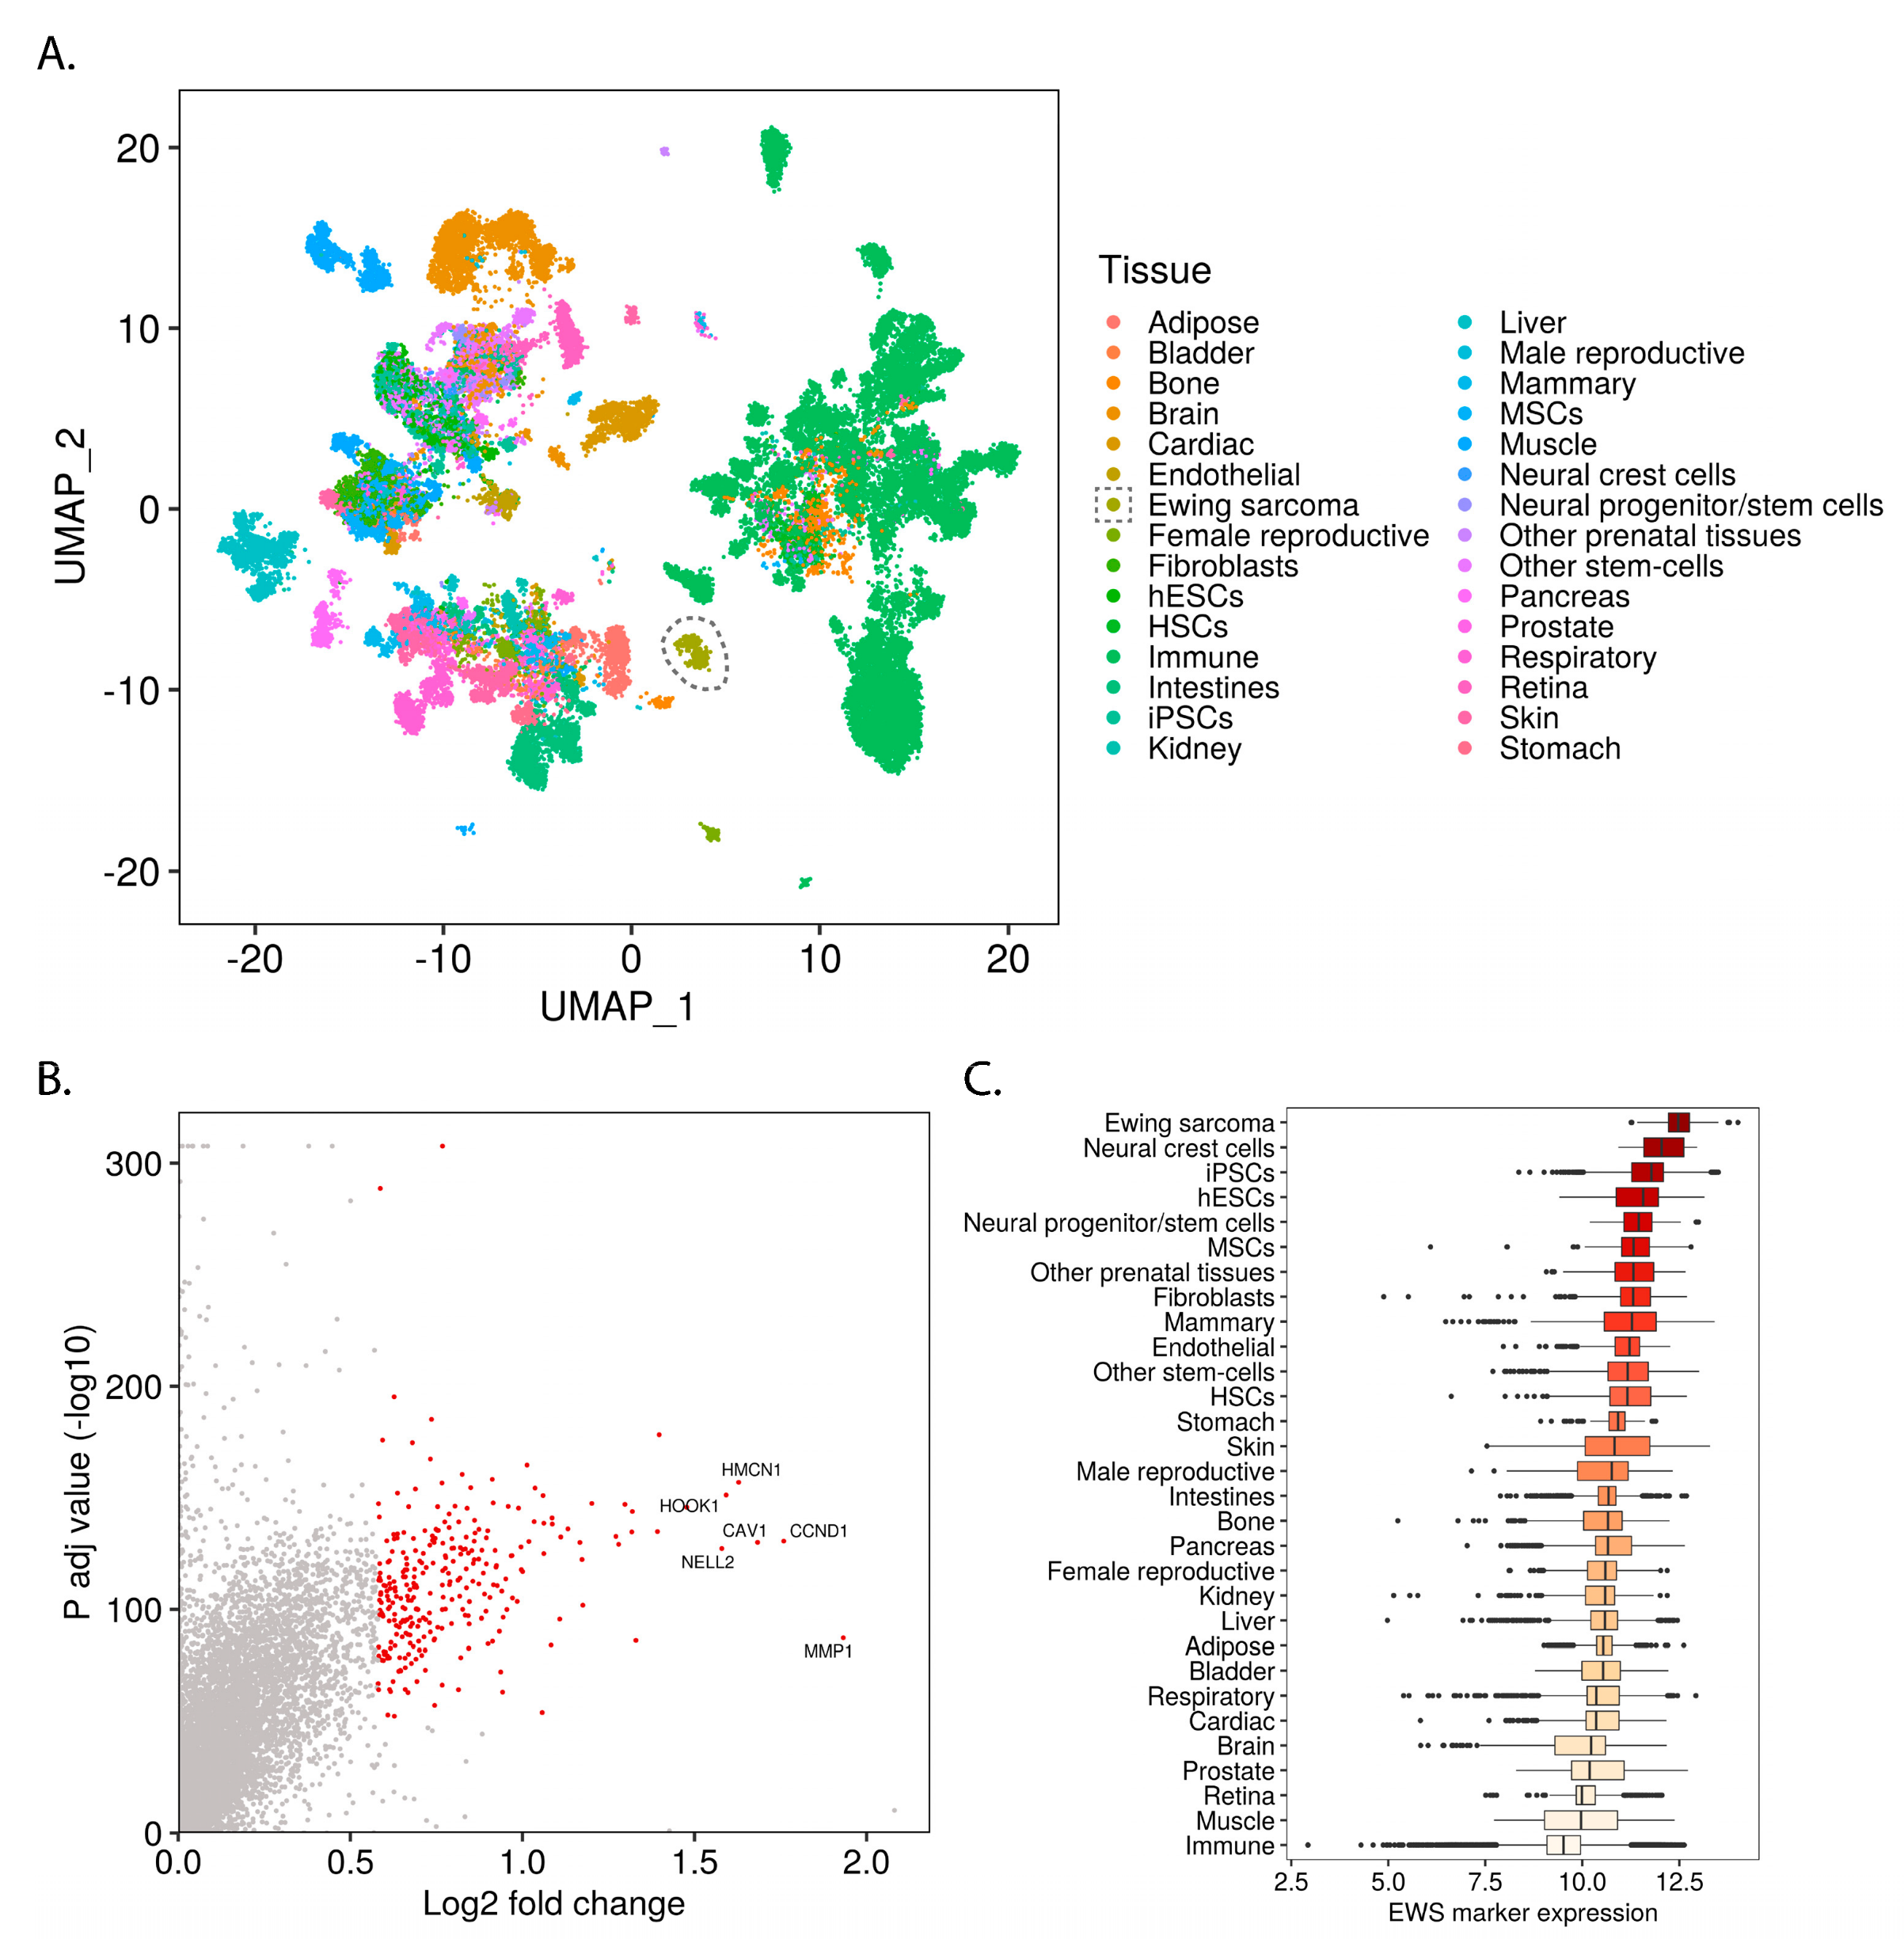
ggplot2: elegant plots using the grammar of graphics

Slide 31
Setting the data layer
pct_surv <- tidy_titanic %>% filter(Age > 12) %>% select(Survived, Sex) %>% group_by(Sex, Survived) %>% summarise(num_sex_survive = n()) %>% mutate(pct_sex_survive = num_sex_survive/sum(num_sex_survive) * 100) %>% filter(Survived == 1)
pct_surv
## # A tibble: 2 x 4 ## # Groups: Sex [2] ## Sex Survived num_sex_survive pct_sex_survive ## <chr> <dbl> <int> <dbl> ## 1 female 1 178 77.7 ## 2 male 1 72 17.3

Slide 32
Setting the data layer
ggplot(data = pct_surv)

Slide 33


Slide 34
Setting the aesthetic layer
ggplot(data = pct_surv, mapping = aes(x = Sex, y = num_sex_survive))

Slide 35
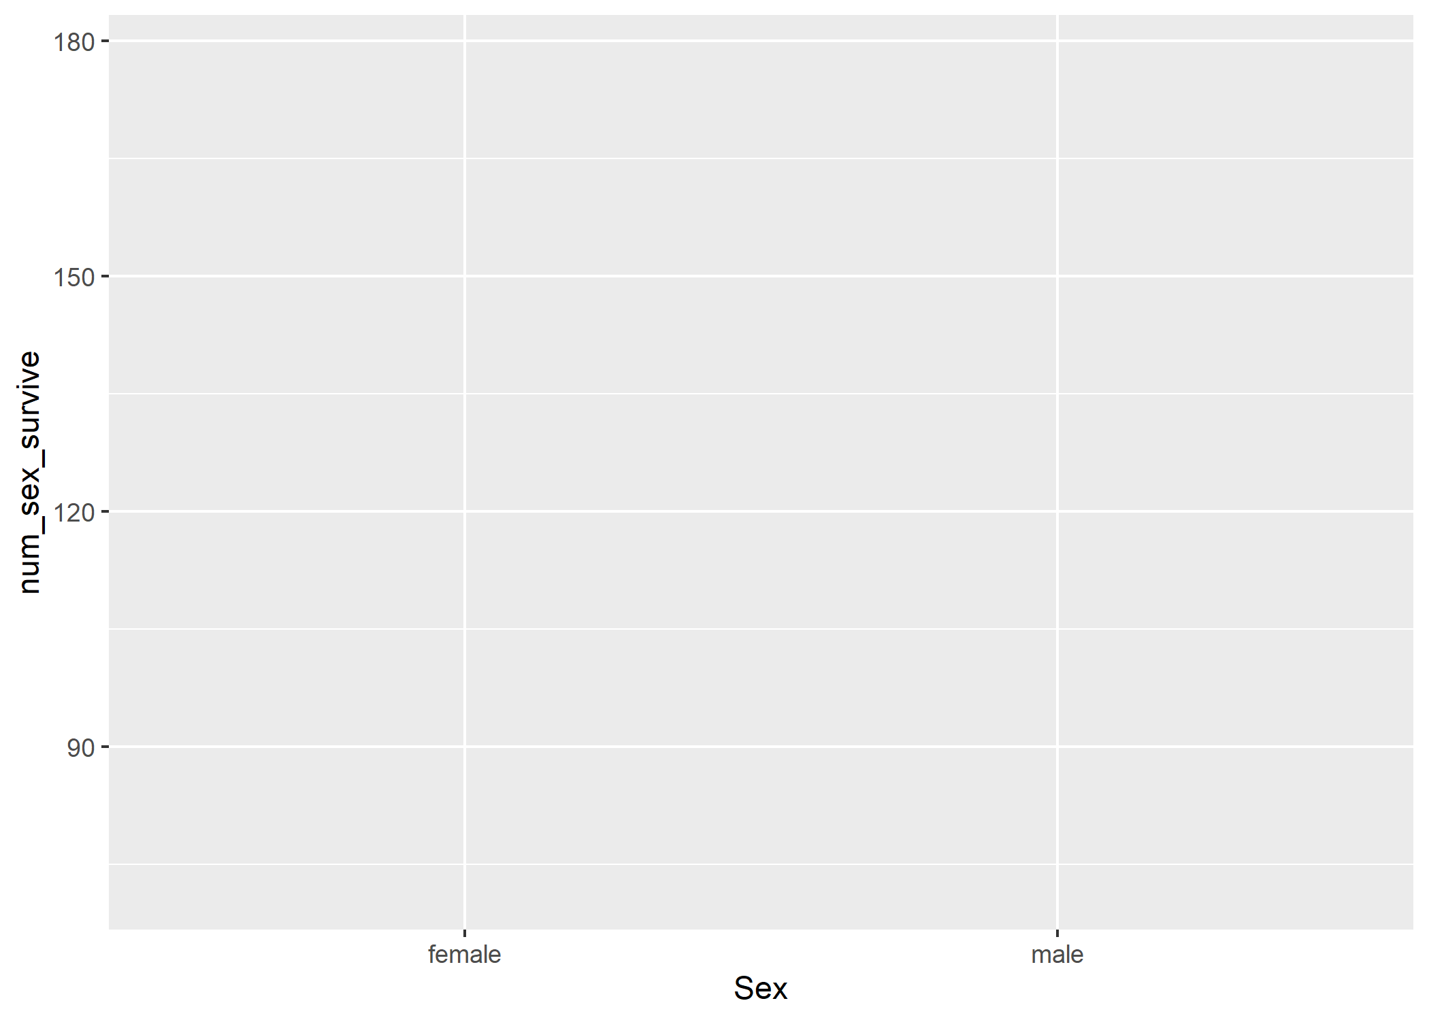

Slide 36
Setting the geometry layer
ggplot(data = pct_surv, mapping = aes(x = Sex, y = num_sex_survive)) + geom_bar(stat = "identity")

Slide 37
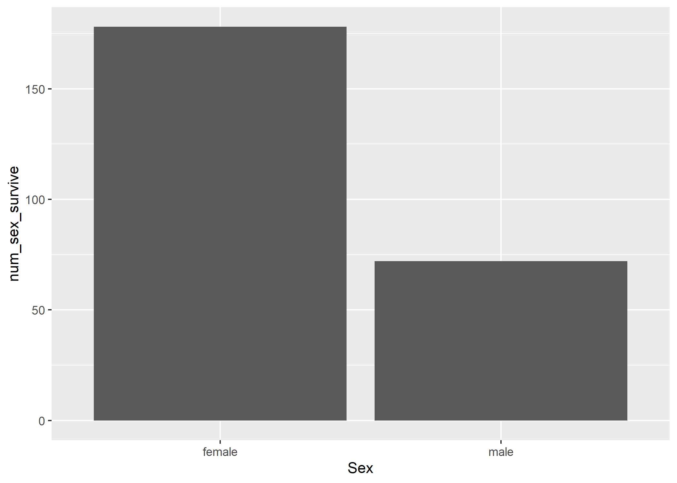

Slide 38
Switching the aesthetics with aes()
ggplot(data = pct_surv, mapping = aes(x = Sex, y = pct_sex_survive)) + geom_bar(stat = "identity")

Slide 39
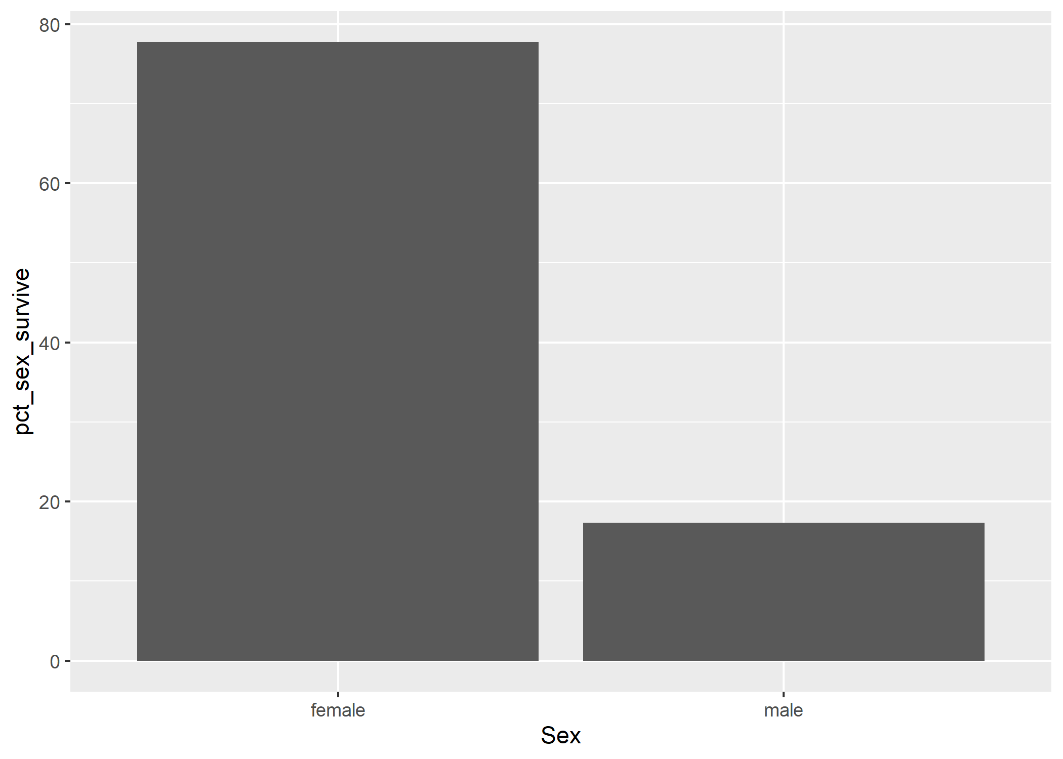

Slide 40
Theme: Changing the y-axis label
ggplot(data = pct_surv, mapping = aes(x = Sex, y = pct_sex_survive)) + geom_bar(stat = "identity") + ylab("Percentage Surviving")

Slide 41
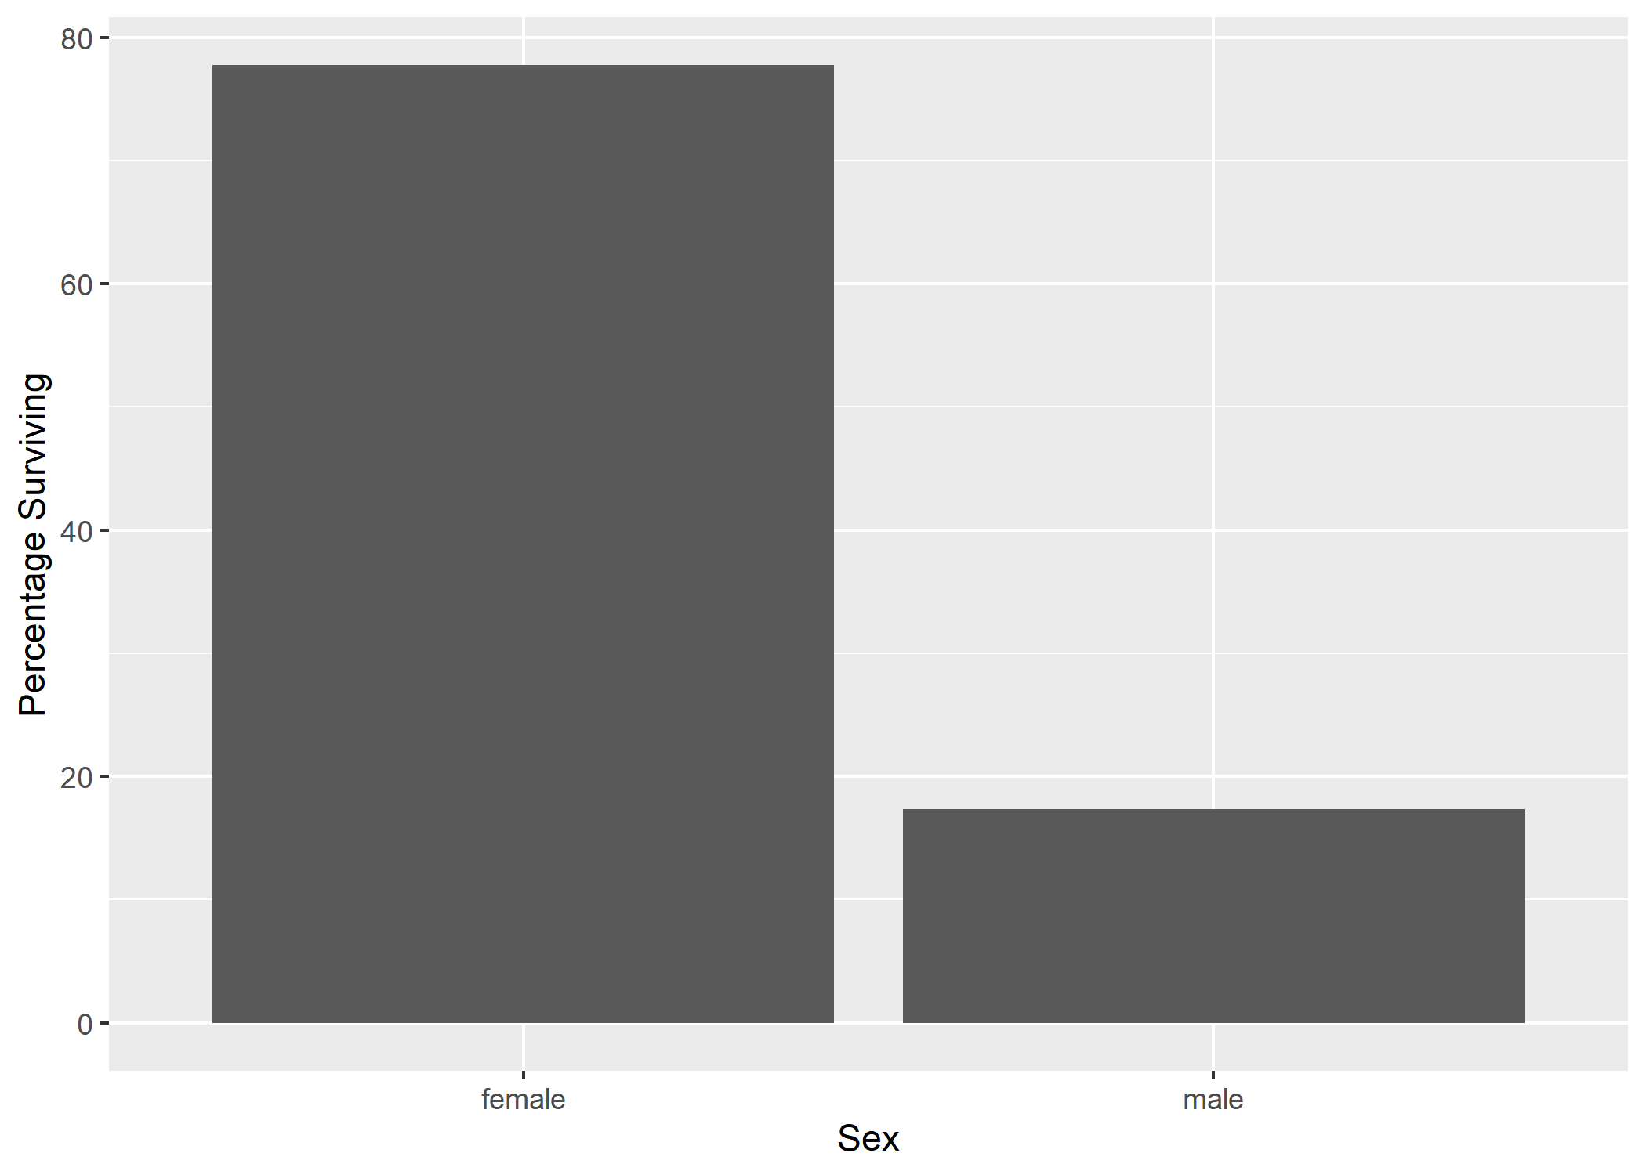

Slide 42
Theme: Adding a title
ggplot(data = pct_surv, mapping = aes(x = Sex, y = pct_sex_survive)) + geom_bar(stat = "identity") + ylab("Percentage Surviving") + labs(title = "Effect of Sex on Survival aboard the Titanic")

Slide 43
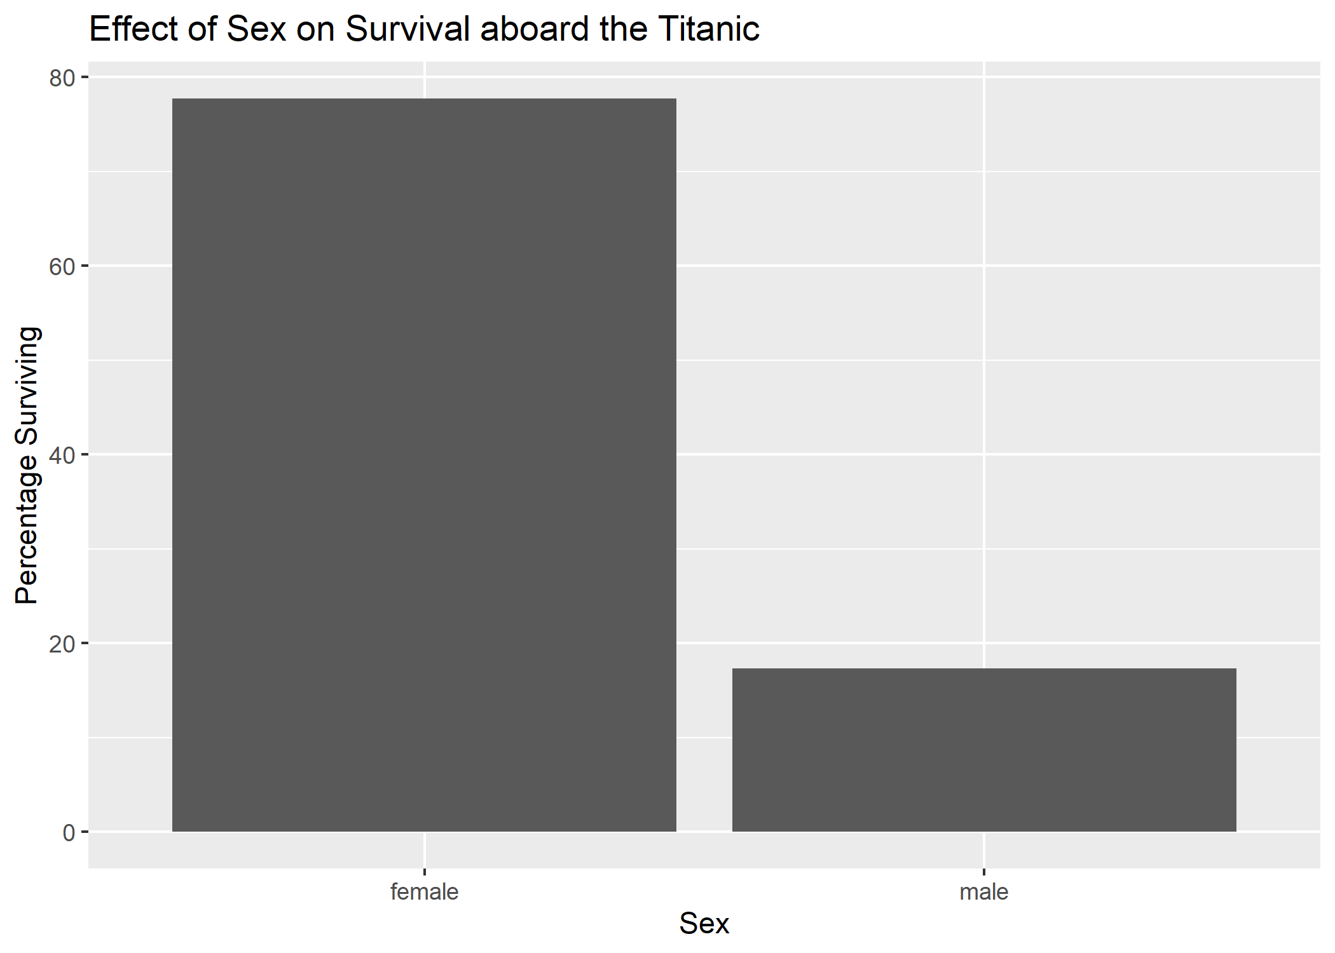

Slide 44
Theme: changing the overall style
ggplot(data = pct_surv, mapping = aes(x = Sex, y = pct_sex_survive)) + geom_bar(stat = "identity") + ylab("Percentage Surviving") + labs(title = "Effect of Sex on Survival aboard the Titanic") + theme_classic()

Slide 45
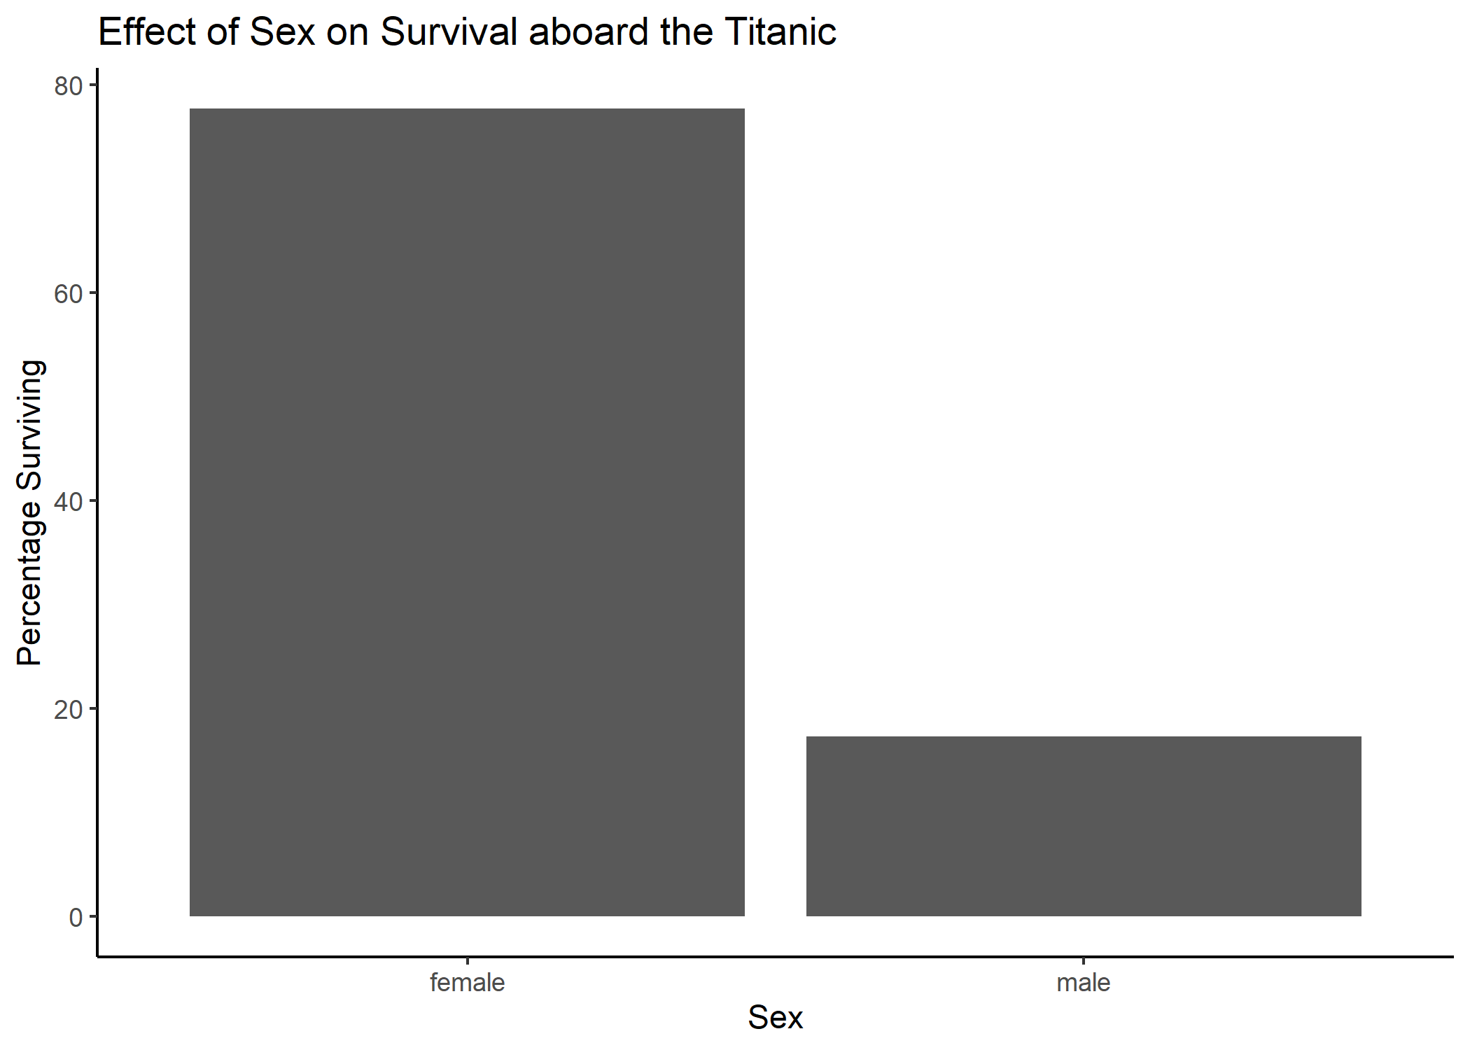

Slide 46
Adding a fill aesthetic
ggplot(data = pct_surv, mapping = aes(x = Sex, y = pct_sex_survive, fill = Sex)) + geom_bar(stat = "identity") + ylab("Percentage Surviving") + labs(title = "Effect of Sex on Survival aboard the Titanic") + theme_classic()

Slide 47
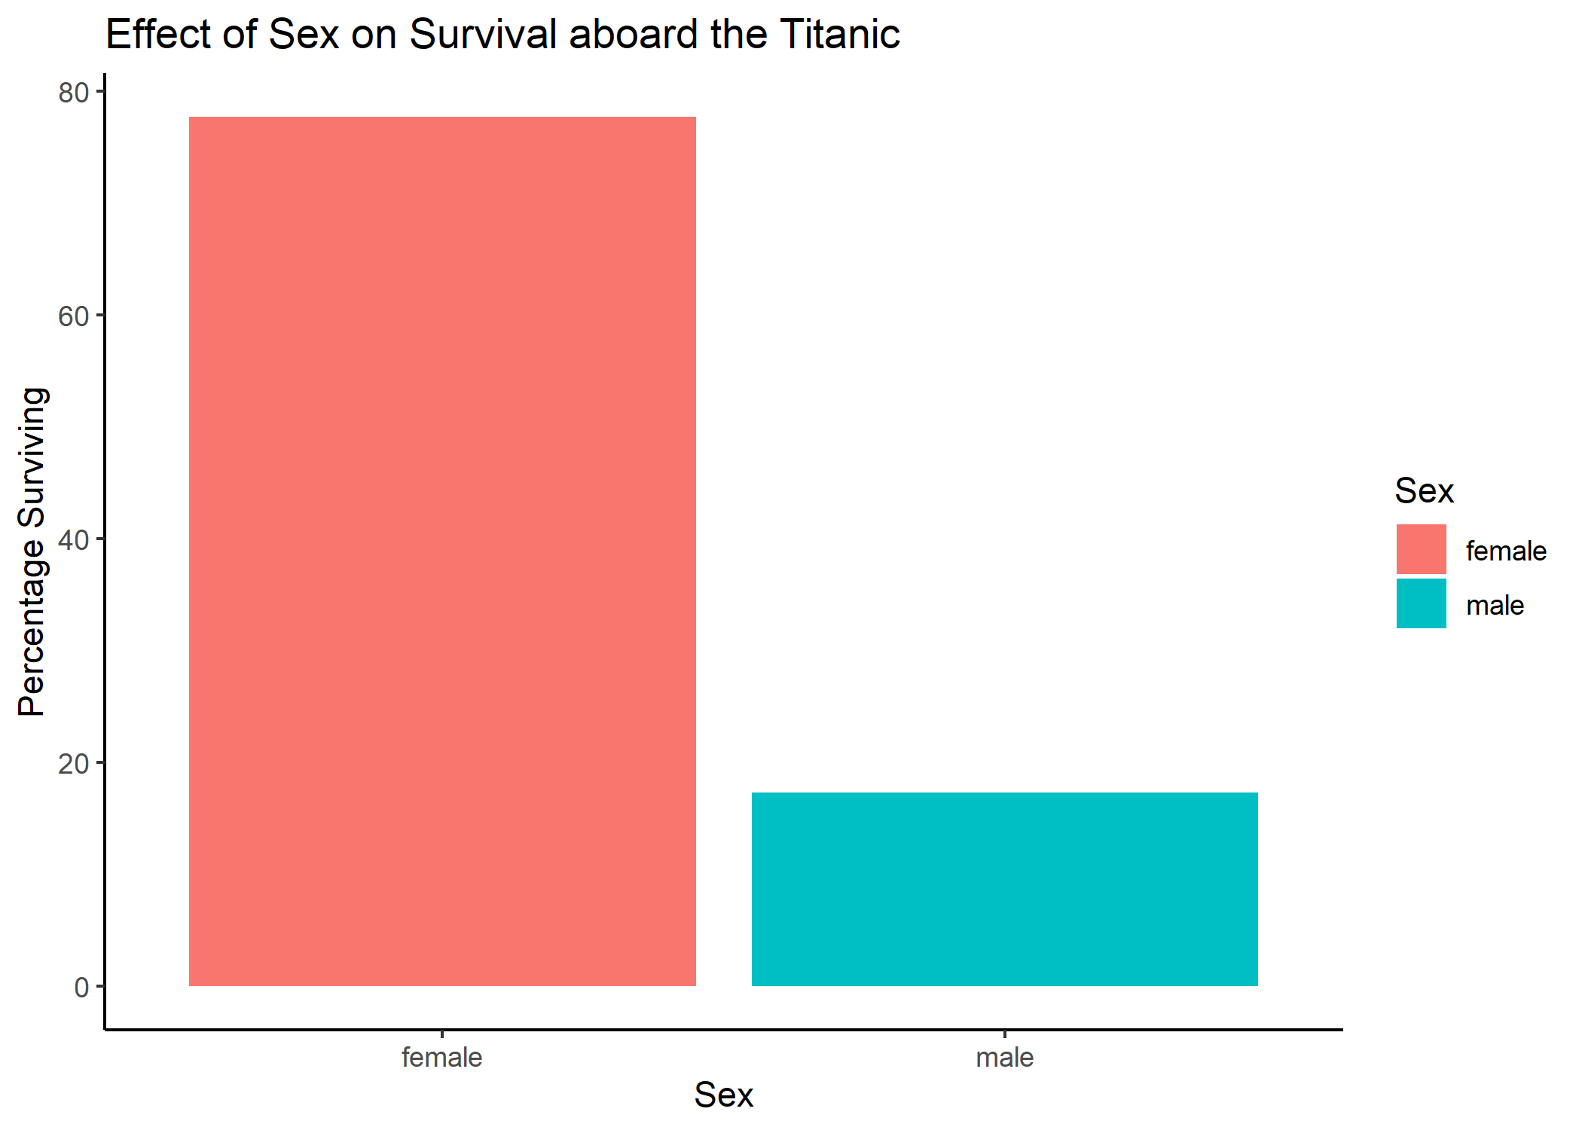

Slide 48
Theme: Remove the x-axis label
ggplot(data = pct_surv, mapping = aes(x = Sex, y = pct_sex_survive, fill = Sex)) + geom_bar(stat = "identity") + ylab("Percentage Surviving") + labs(title = "Effect of Sex on Survival aboard the Titanic") + theme_classic() + xlab(NULL)

Slide 49
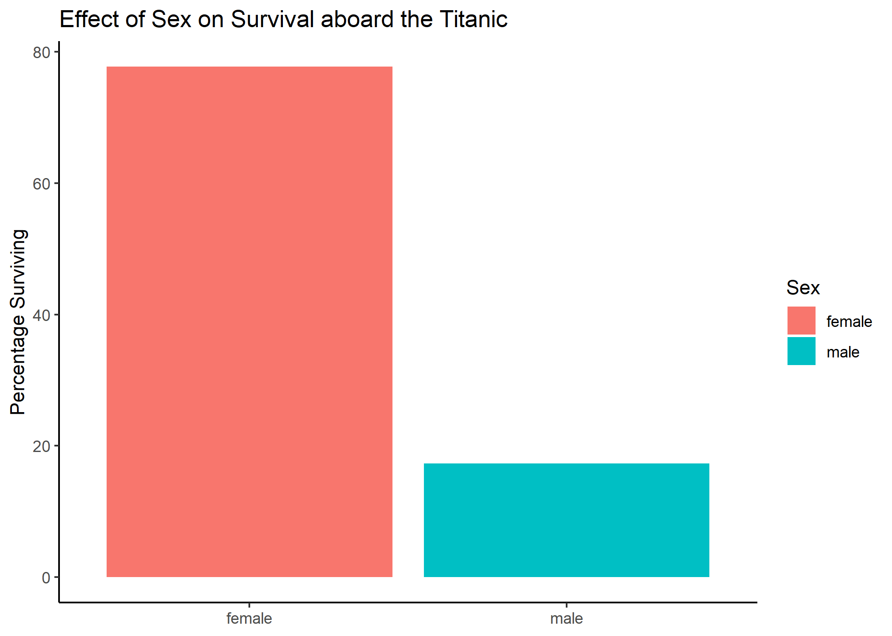

Slide 50
Theme: removing a legend
ggplot(data = pct_surv, mapping = aes(x = Sex, y = pct_sex_survive, fill = Sex)) + geom_bar(stat = "identity") + ylab("Percentage Surviving") + labs(title = "Effect of Sex on Survival aboard the Titanic") + theme_classic() + xlab(NULL) + theme(legend.position = "none")

Slide 51
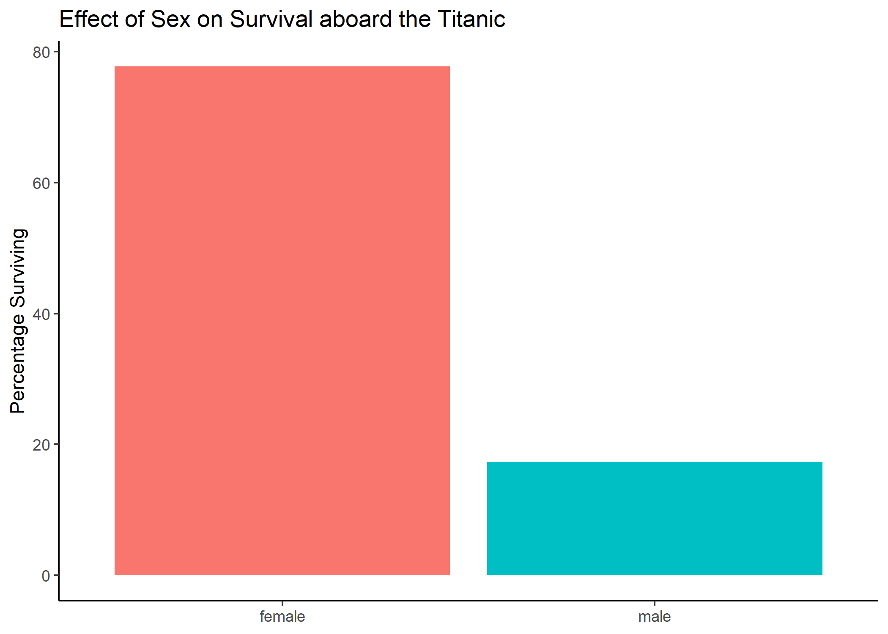

Slide 52
Coordinates: adjusting the y-axis scale
ggplot(data = pct_surv, mapping = aes(x = Sex, y = pct_sex_survive, fill = Sex)) + geom_bar(stat = "identity") + ylab("Percentage Surviving") + labs(title = "Effect of Sex on Survival aboard the Titanic") + theme_classic() + xlab(NULL) + theme(legend.position = "none") + scale_y_continuous(limits = c(0, 100), expand = c(0, 0))

Slide 53
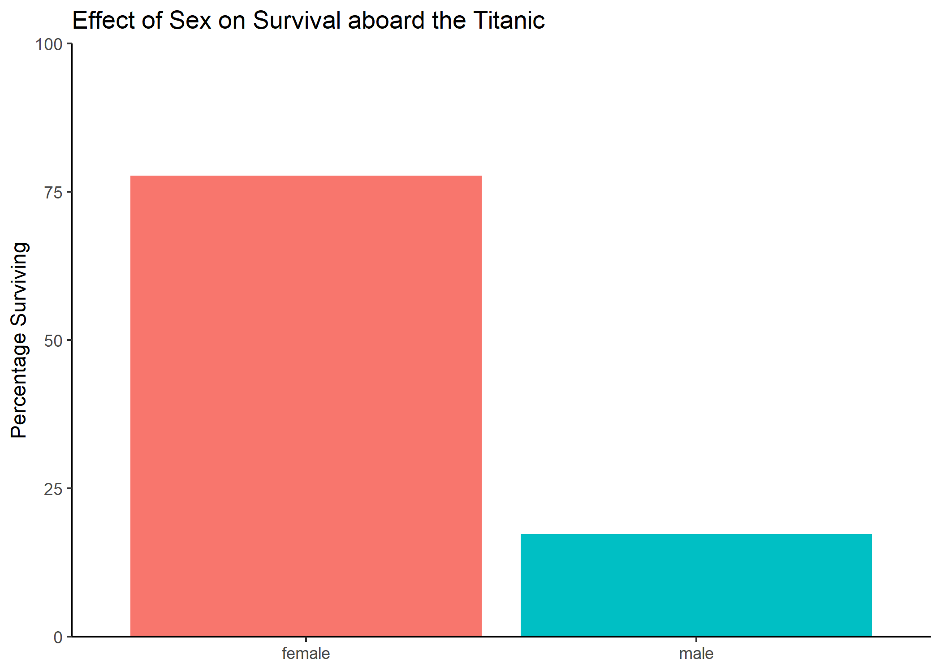

Slide 54
Coordinates: adjust the x-axis text labels
ggplot(data = pct_surv, mapping = aes(x = Sex, y = pct_sex_survive, fill = Sex)) + geom_bar(stat = "identity") + ylab("Percentage Surviving") + labs(title = "Effect of Sex on Survival aboard the Titanic") + theme_classic() + xlab(NULL) + theme(legend.position = "none") + scale_y_continuous(limits = c(0, 100), expand = c(0, 0)) + scale_x_discrete(labels = c("Female", "Male"))

Slide 55


Slide 56
Theme: Setting the font size
ggplot(data = pct_surv, mapping = aes(x = Sex, y = pct_sex_survive, fill = Sex)) + geom_bar(stat = "identity") + ylab("Percentage Surviving") + labs(title = "Effect of Sex on Survival aboard the Titanic") + theme_classic(base_size = 17) + xlab(NULL) + theme(legend.position = "none") + scale_y_continuous(limits = c(0, 100), expand = c(0, 0)) + scale_x_discrete(labels = c("Female", "Male"))

Slide 57
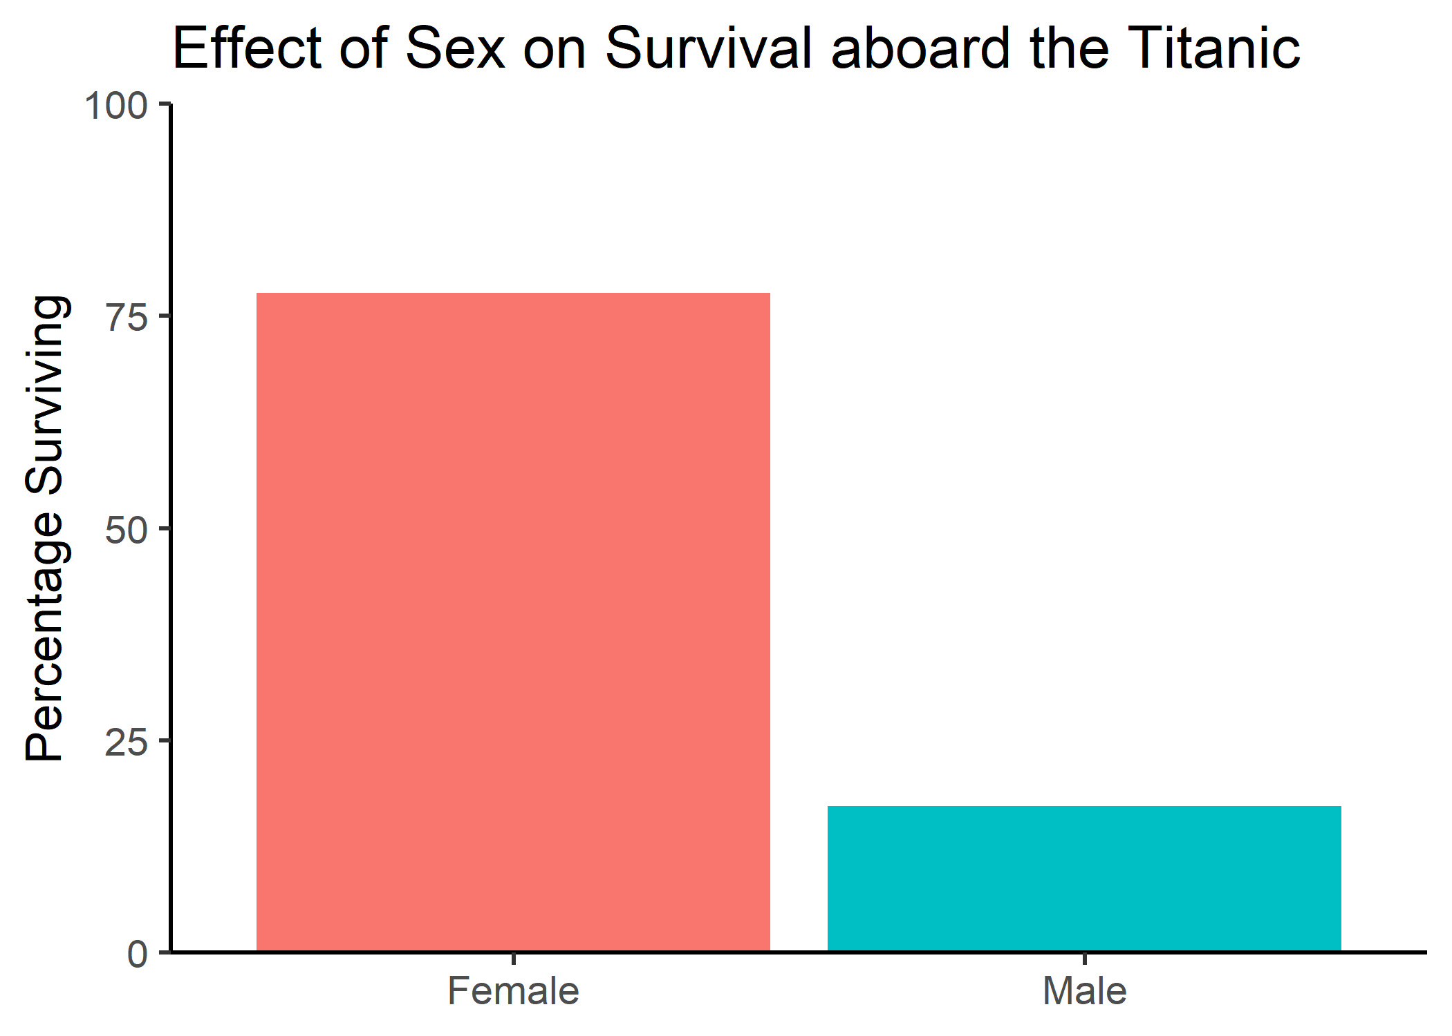

Slide 58
Assigning ggplots to a variable
my_figure <- ggplot(data = pct_surv, mapping = aes(x = Sex, y = pct_sex_survive, fill = Sex)) + geom_bar(stat = "identity") + ylab("Percentage Surviving") + labs(title = "Effect of Sex on Survival aboard the Titanic") + theme_classic(base_size = 17) + xlab(NULL) + theme(legend.position = "none") + scale_y_continuous(limits = c(0, 100), expand = c(0, 0)) + scale_x_discrete(labels = c("Female", "Male")) my_figure

Slide 60
Saving a plot with ggsave()
ggsave(plot = my_figure, filename = "my_fig.png", width = 7, height = 4.5)

Slide 62
All together now
read_csv("https://gist.githubusercontent.com/michhar/2dfd2de0d4f8727f873422c5d959fff5/raw/fa71405126017e6a37bea592440b4bee94bf7b9e/titanic.csv") %>% # Read the data into a tibble filter(Age > 12) %>% # Only keep passengers with known Age select(Survived, Sex) %>% # Only keep the Survived and Sex columns group_by(Sex, Survived) %>% # Group by Sex and then Survived summarise(num_sex_survive = n()) %>% # Count the number of passengers in these groups mutate(pct_sex_survive = num_sex_survive/sum(num_sex_survive) * 100) %>% # Calculate the percent surviving filter(Survived == 1) %>% # Only keep the surviving passengers ggplot(mapping = aes(x = Sex, y = pct_sex_survive, fill = Sex)) + # Build the data and aesthetic layers geom_bar(stat = "identity") + # Build the geometric layer as a bar plot ylab("Percentage Surviving") + # Make a Y axis label labs(title = "Effect of Sex on Survival aboard the Titanic") + # Add a title theme_classic(base_size = 17) + # Increase the font size and set a nice theme xlab(NULL) + # Remove the X axis label theme(legend.position = "none") + # Remove the legend scale_y_continuous(limits = c(0, 100), expand = c(0, 0)) + # Set Y axis limits and remove the expansion scale_x_discrete(labels = c("Female", "Male")) + # Capitalize the X axis Sex labels ggsave(filename = "my_fig.png", width = 7, height = 4.5)

Slide 63
Hands-on activity #2
15 minutes

Slide 64
Does Fare predict Survival?
read_csv("https://gist.githubusercontent.com/michhar/2dfd2de0d4f8727f873422c5d959fff5/raw/fa71405126017e6a37bea592440b4bee94bf7b9e/titanic.csv") %>% ggplot(mapping = aes(x = Survived, y = Fare))

Slide 65
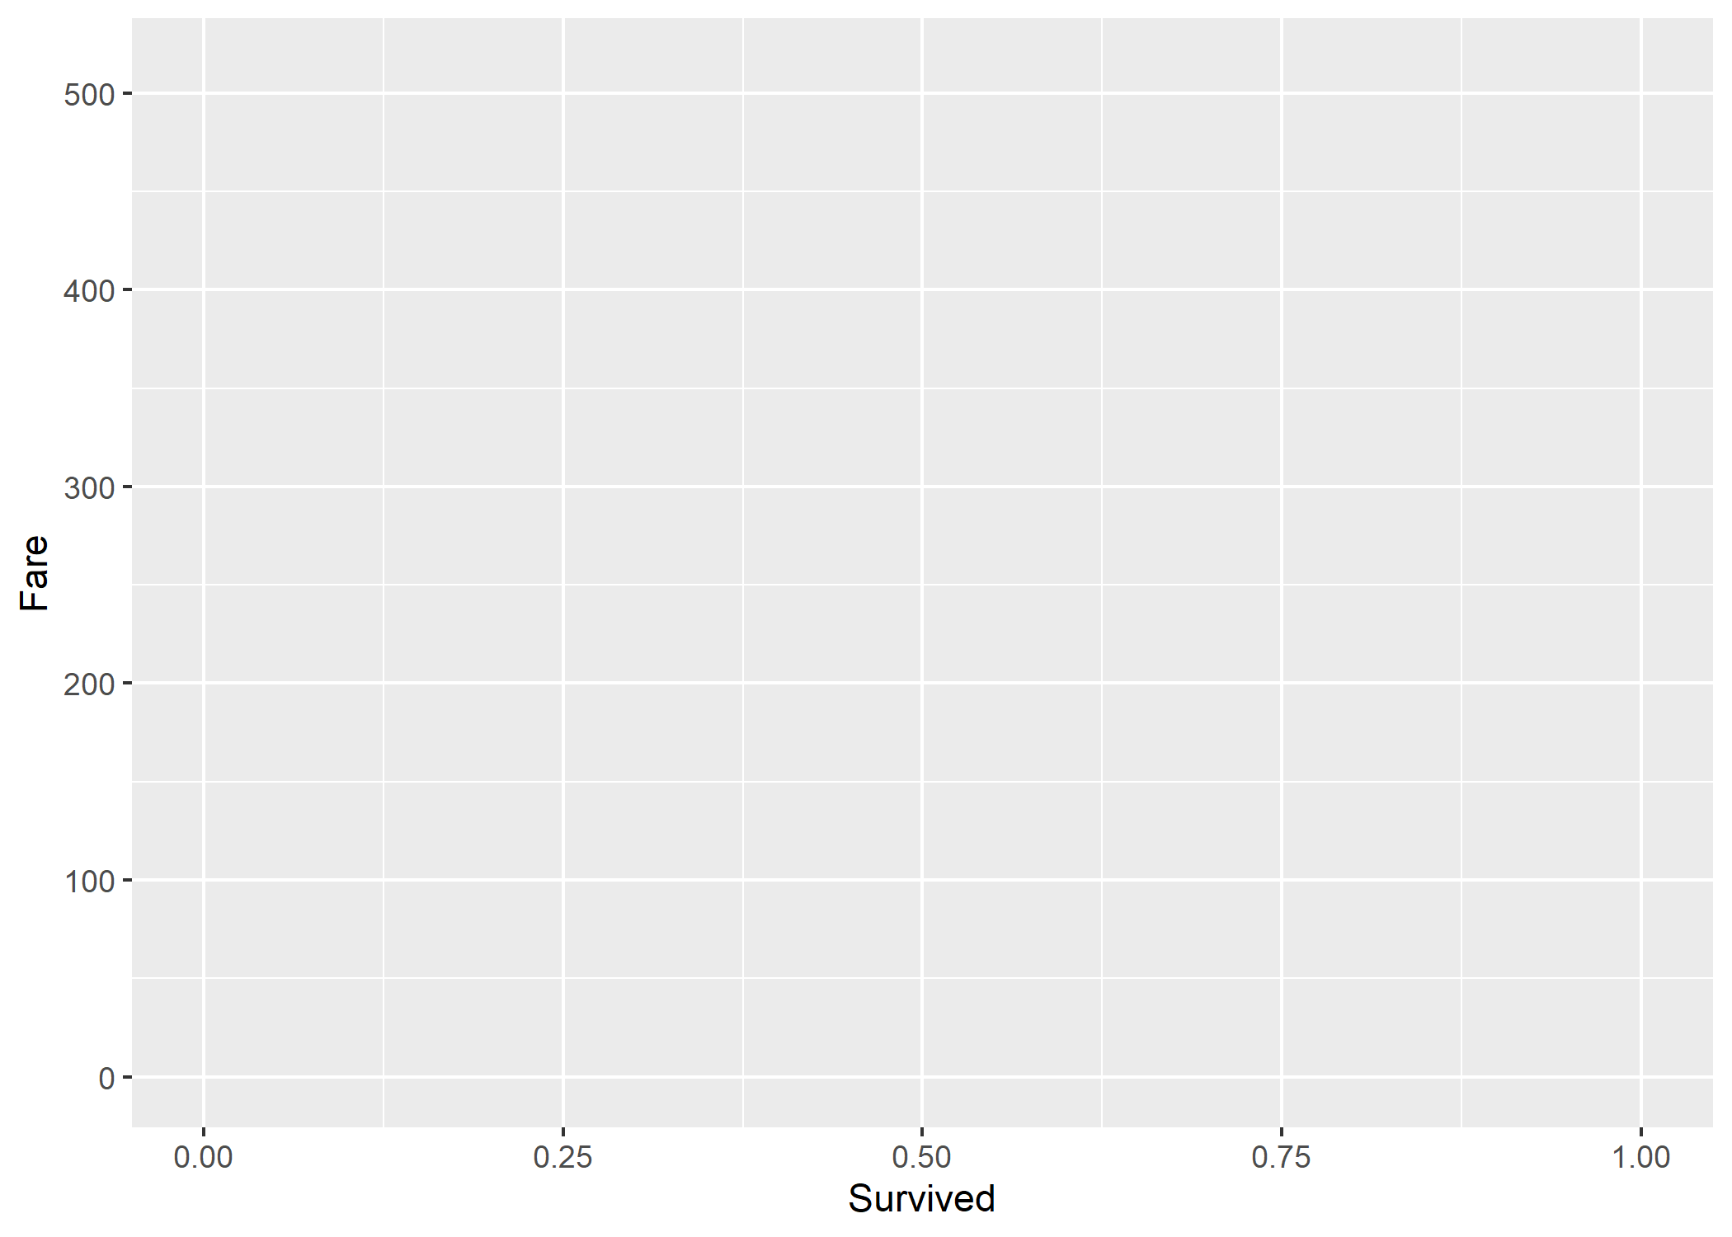

Slide 66
Survived is being treated as a continuous variable
read_csv("https://gist.githubusercontent.com/michhar/2dfd2de0d4f8727f873422c5d959fff5/raw/fa71405126017e6a37bea592440b4bee94bf7b9e/titanic.csv") %>% # Read the data into a tibble select(Survived)

Slide 67
Survived is being treated as a continuous variable
read_csv("https://gist.githubusercontent.com/michhar/2dfd2de0d4f8727f873422c5d959fff5/raw/fa71405126017e6a37bea592440b4bee94bf7b9e/titanic.csv") %>% # Read the data into a tibble select(Survived)
## # A tibble: 891 x 1 ## Survived ## <dbl> ## 1 0 ## 2 1 ## 3 1 ## 4 1 ## 5 0 ## 6 0 ## 7 0 ## 8 0 ## 9 1 ## 10 1 ## # ... with 881 more rows

Slide 68
Factorizing Survived to make it discrete
read_csv("https://gist.githubusercontent.com/michhar/2dfd2de0d4f8727f873422c5d959fff5/raw/fa71405126017e6a37bea592440b4bee94bf7b9e/titanic.csv") %>% ggplot(mapping = aes(x = factor(Survived), y = Fare))

Slide 69
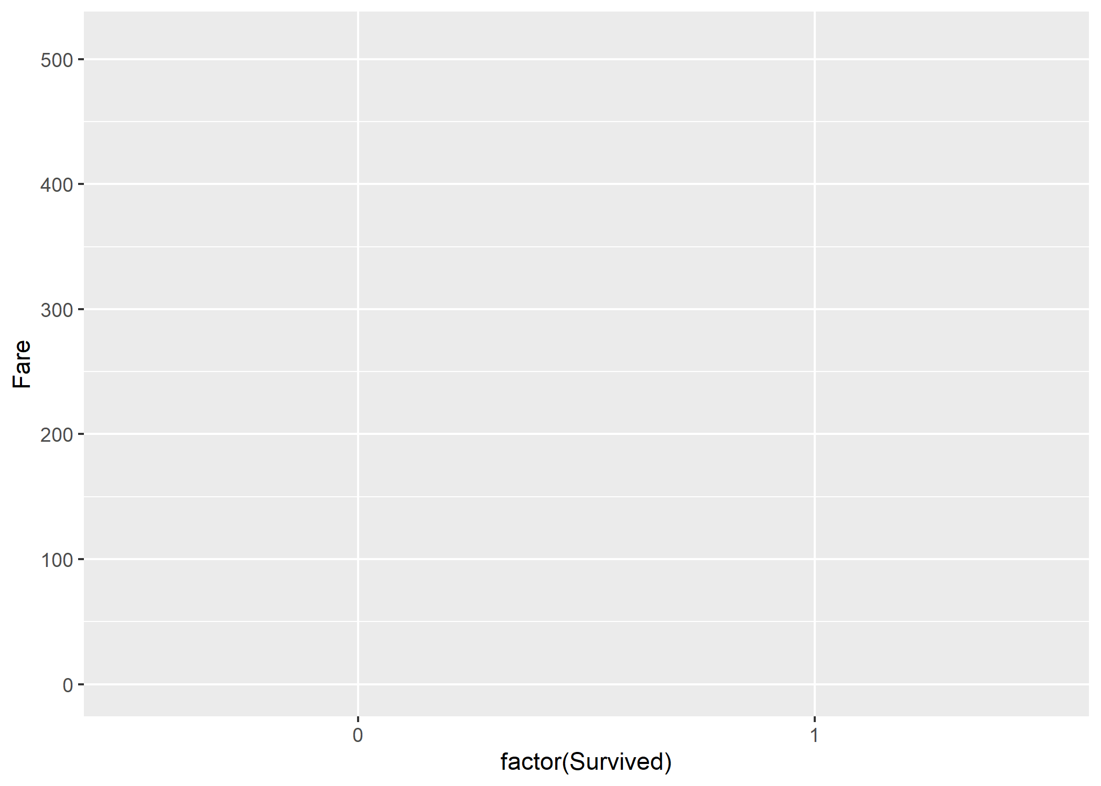

Slide 70
Add factor labels to improve readability
read_csv("https://gist.githubusercontent.com/michhar/2dfd2de0d4f8727f873422c5d959fff5/raw/fa71405126017e6a37bea592440b4bee94bf7b9e/titanic.csv") %>% ggplot(mapping = aes(x = factor(Survived, labels = c("Died", "Survived")), y = Fare))

Slide 71
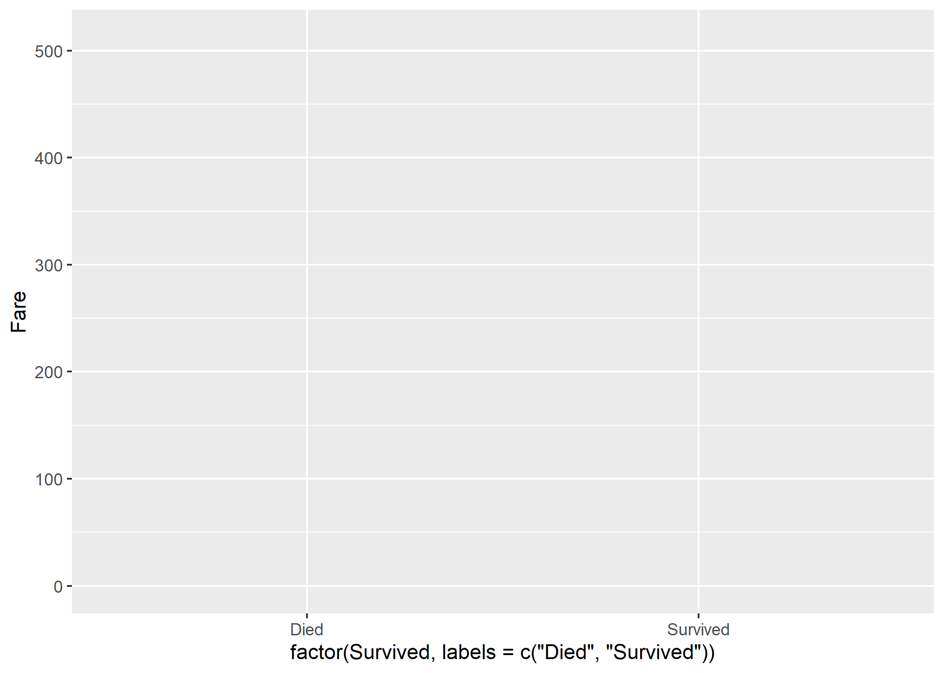

Slide 72
Add the geometry layer
read_csv("https://gist.githubusercontent.com/michhar/2dfd2de0d4f8727f873422c5d959fff5/raw/fa71405126017e6a37bea592440b4bee94bf7b9e/titanic.csv") %>% ggplot(mapping = aes(x = factor(Survived, labels = c("Died", "Survived")), y = Fare)) + geom_boxplot()

Slide 73
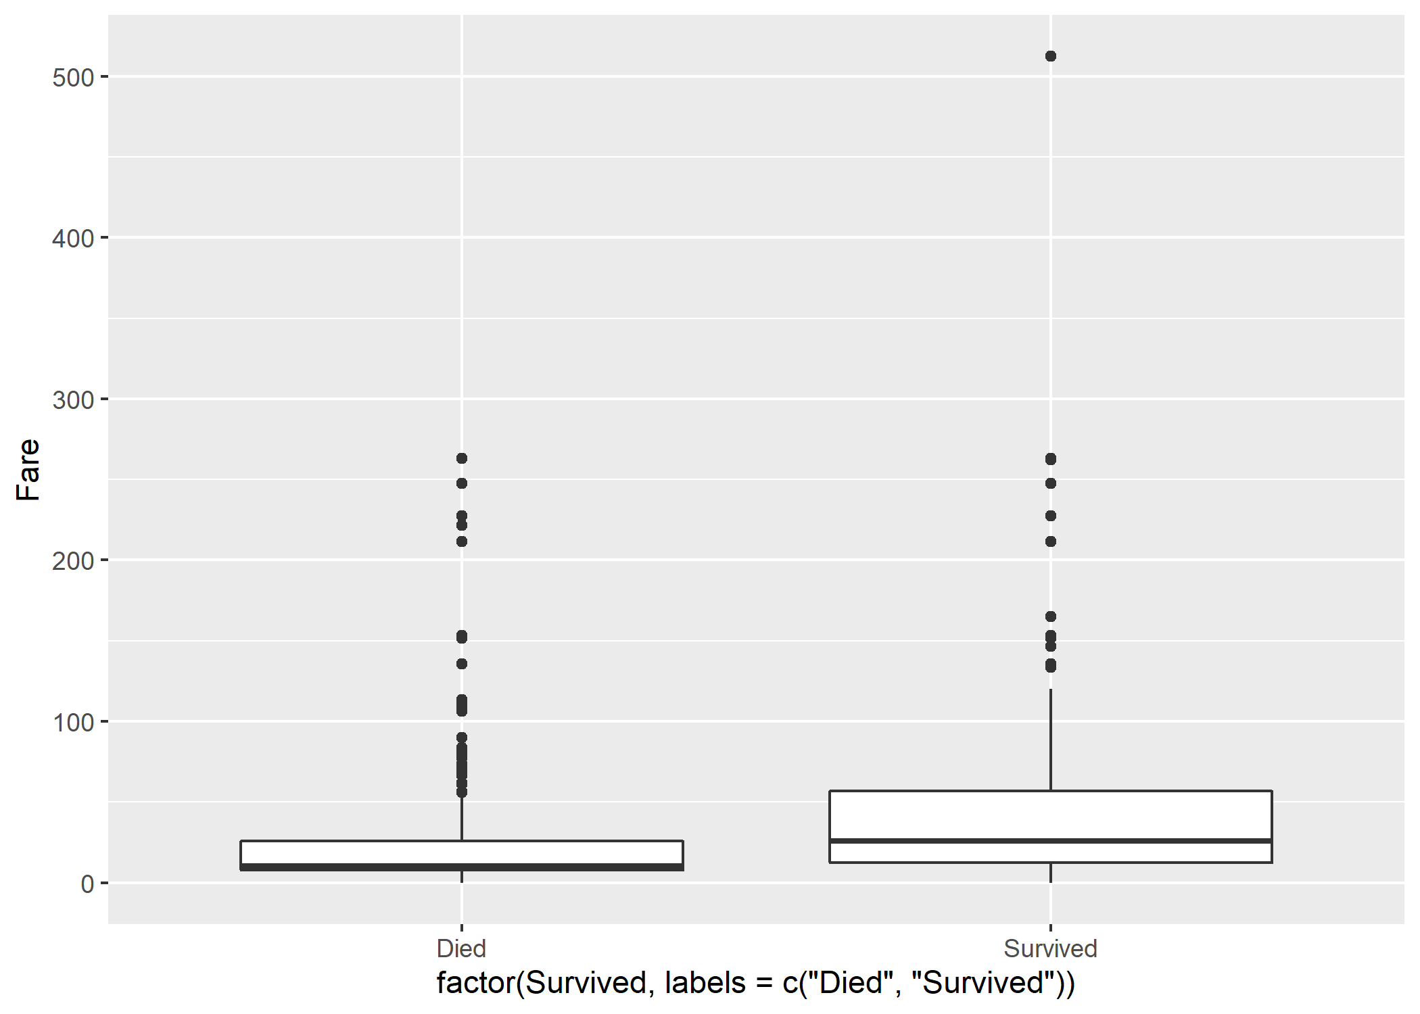

Slide 74
Coordinates: log-scale for y-axis
read_csv("https://gist.githubusercontent.com/michhar/2dfd2de0d4f8727f873422c5d959fff5/raw/fa71405126017e6a37bea592440b4bee94bf7b9e/titanic.csv") %>% filter(Fare > 0) %>% ggplot(mapping = aes(x = factor(Survived, labels = c("Died", "Survived")), y = Fare)) + geom_boxplot() + scale_y_log10()

Slide 75
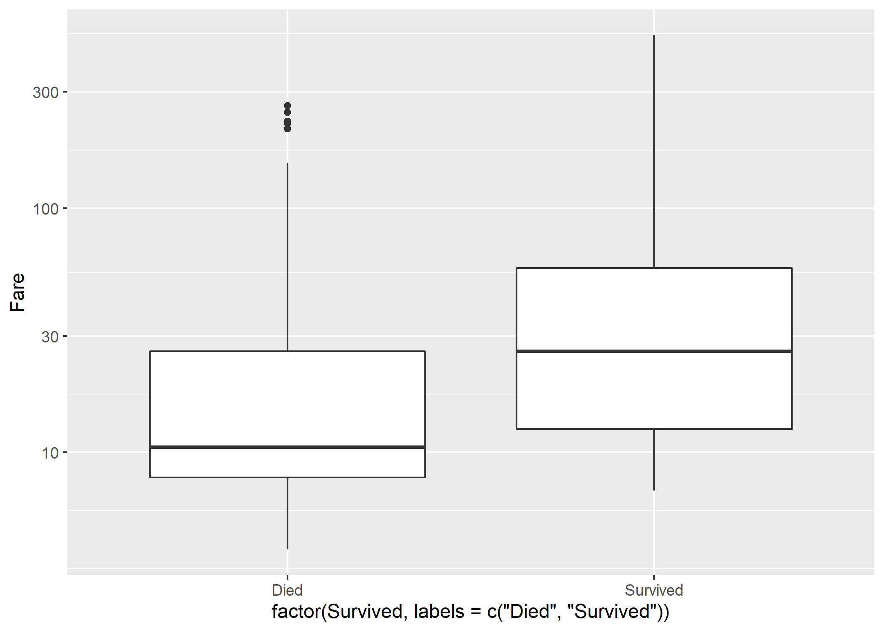

Slide 76
Is age a confounding variable here?
read_csv("https://gist.githubusercontent.com/michhar/2dfd2de0d4f8727f873422c5d959fff5/raw/fa71405126017e6a37bea592440b4bee94bf7b9e/titanic.csv") %>% filter(is.numeric(Age) & Fare > 0) %>% mutate(Age_bracket = case_when( Age > 60 ~ "Senior", Age < 16 ~ "Child", TRUE ~ "Adult" # This TRUE is equivalent to "else" in if...else ))

Slide 77
Facets: split the plot by age bracket
read_csv("https://gist.githubusercontent.com/michhar/2dfd2de0d4f8727f873422c5d959fff5/raw/fa71405126017e6a37bea592440b4bee94bf7b9e/titanic.csv") %>% filter(is.numeric(Age) & Fare > 0) %>% mutate(Age_bracket = case_when( Age > 60 ~ "Senior", Age < 16 ~ "Child", TRUE ~ "Adult" # This TRUE is equivalent to "else" in if...else )) %>% ggplot(mapping = aes(x = factor(Survived, labels = c("Died", "Survived")), y = Fare)) + geom_boxplot() + scale_y_log10() + facet_wrap(~ Age_bracket)

Slide 78
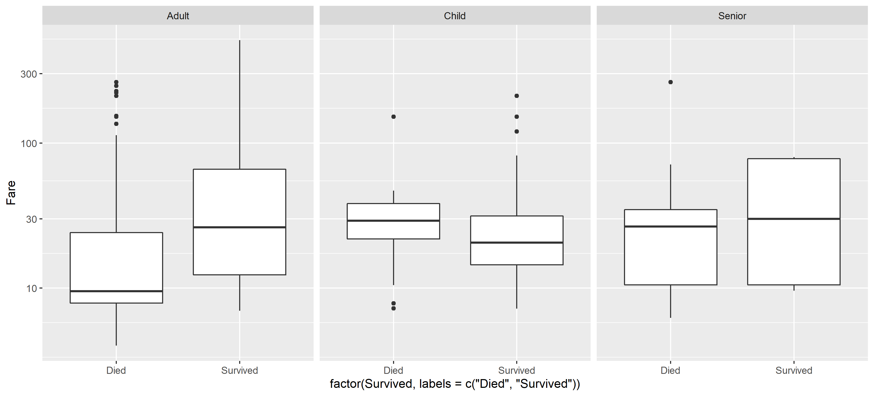

Slide 79
Install and load ggpubr
# install.packages("ggpubr") library(ggpubr)

Slide 80
Statics: t-test to determine p values
read_csv("https://gist.githubusercontent.com/michhar/2dfd2de0d4f8727f873422c5d959fff5/raw/fa71405126017e6a37bea592440b4bee94bf7b9e/titanic.csv") %>% filter(is.numeric(Age) & Fare > 0) %>% mutate(Age_bracket = case_when( Age > 60 ~ "Senior", Age < 16 ~ "Child", TRUE ~ "Adult" # This TRUE is equivalent to "else" in if...else )) %>% ggplot(mapping = aes(x = factor(Survived, labels = c("Died", "Survived")), y = Fare)) + geom_boxplot() + scale_y_log10() + facet_wrap(~ Age_bracket) + stat_compare_means(method = "t.test")

Slide 81
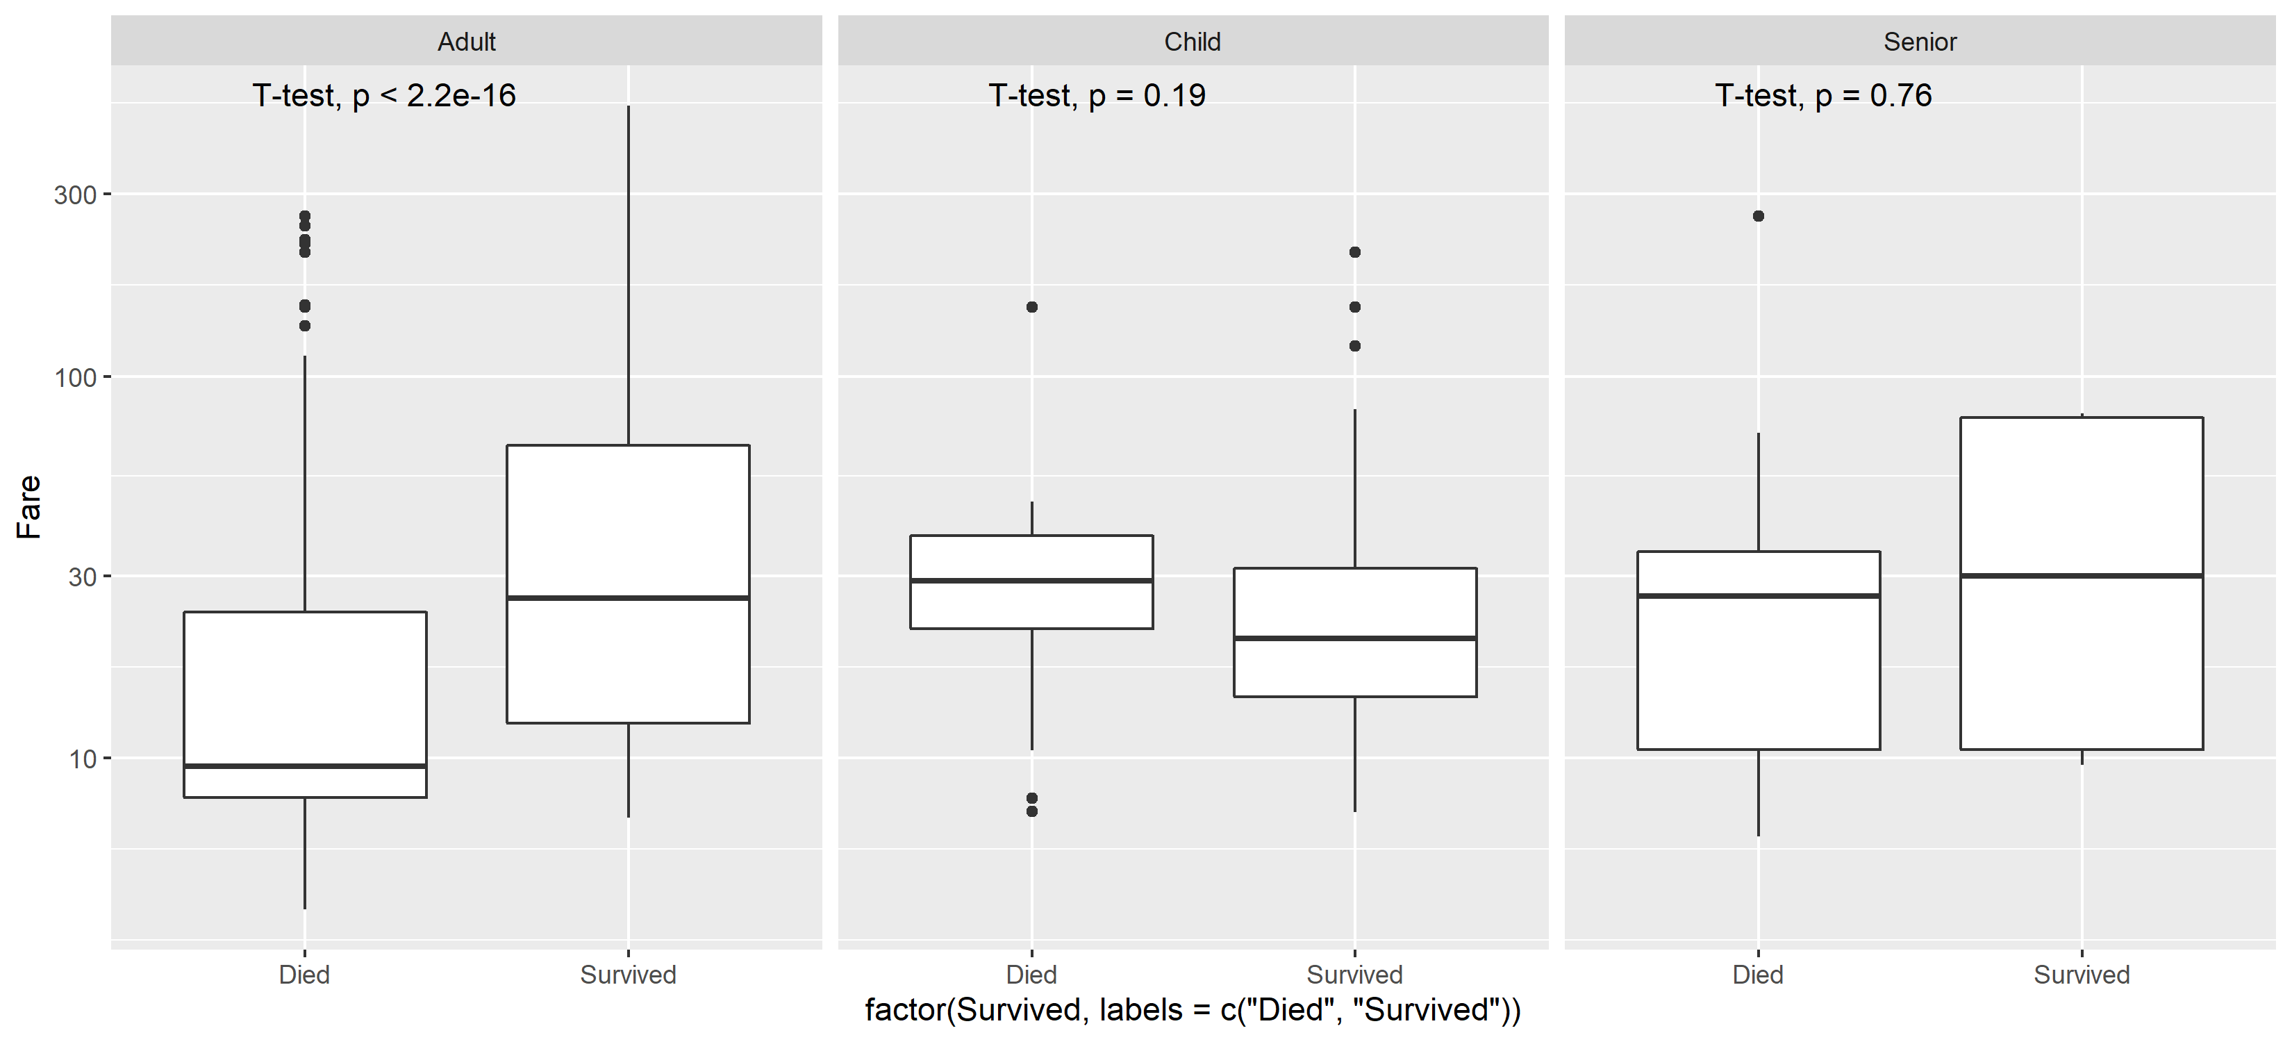

Slide 82
Relationship between Age and Fare Price3
read_csv("https://gist.githubusercontent.com/michhar/2dfd2de0d4f8727f873422c5d959fff5/raw/fa71405126017e6a37bea592440b4bee94bf7b9e/titanic.csv") %>% filter(is.numeric(Age) & Fare > 0) %>% mutate(Age_bracket = case_when( Age > 60 ~ "Senior", Age < 16 ~ "Child", TRUE ~ "Adult" # This TRUE is equivalent to "else" in if...else )) %>% ggplot(mapping = aes(x = factor(Survived, labels = c("Died", "Survived")), y = Fare)) + geom_boxplot() + scale_y_log10() + facet_wrap(~ Age_bracket) + stat_compare_means(method = "t.test", label = "p.signif")

Slide 83


Slide 84
Relationship between Age and Fare Price4
read_csv("https://gist.githubusercontent.com/michhar/2dfd2de0d4f8727f873422c5d959fff5/raw/fa71405126017e6a37bea592440b4bee94bf7b9e/titanic.csv") %>% filter(is.numeric(Age) & Fare > 0) %>% mutate(Age_bracket = case_when( Age > 60 ~ "Senior", Age < 16 ~ "Child", TRUE ~ "Adult" # This TRUE is equivalent to "else" in if...else )) %>% ggplot(mapping = aes(x = factor(Survived, labels = c("Died", "Survived")), y = Fare)) + geom_boxplot() + scale_y_log10() + facet_wrap(~ Age_bracket) + stat_compare_means(method = "t.test", label = "p.signif", comparisons = list(c("Died", "Survived")))

Slide 85
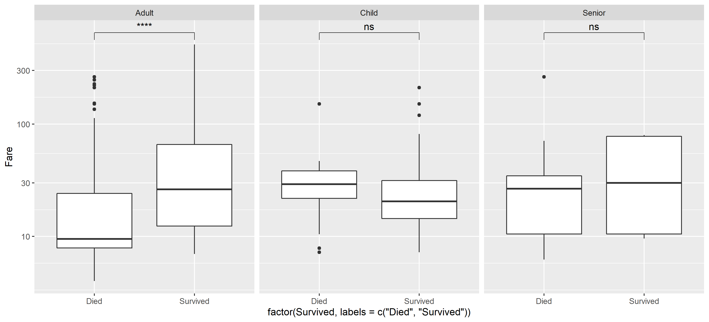

Slide 86
Relationship between Age and Fare Price5
read_csv("https://gist.githubusercontent.com/michhar/2dfd2de0d4f8727f873422c5d959fff5/raw/fa71405126017e6a37bea592440b4bee94bf7b9e/titanic.csv") %>% filter(is.numeric(Age) & Fare > 0) %>% mutate(Age_bracket = case_when( Age > 60 ~ "Senior", Age < 16 ~ "Child", TRUE ~ "Adult" # This TRUE is equivalent to "else" in if...else )) %>% ggplot(mapping = aes(x = factor(Survived, labels = c("Died", "Survived")), y = Fare, fill = factor(Survived, labels = c("Died", "Survived")))) + geom_boxplot() + scale_y_log10(limits = c(2, 1000)) + facet_wrap(~ Age_bracket) + stat_compare_means(method = "t.test", label = "p.signif", comparisons = list(c("Died", "Survived"))) + xlab(NULL) + ylab("Ticket Price (log scale)") + theme_bw(base_size = 17) + theme(legend.position = "none") + scale_fill_manual(values = c("goldenrod", "skyblue")) + ggsave(filename = "my_figure.png", height = 5, width = 11)

Slide 87
